Slide 1
Digital Marketing Tools

Slide 2
Learning Outcomes
What are Digital Marketing Tools?
Why are the Digital Marketing Tools Important?
Useful Digital Marketing Tools for Business
List of various tools

Slide 3
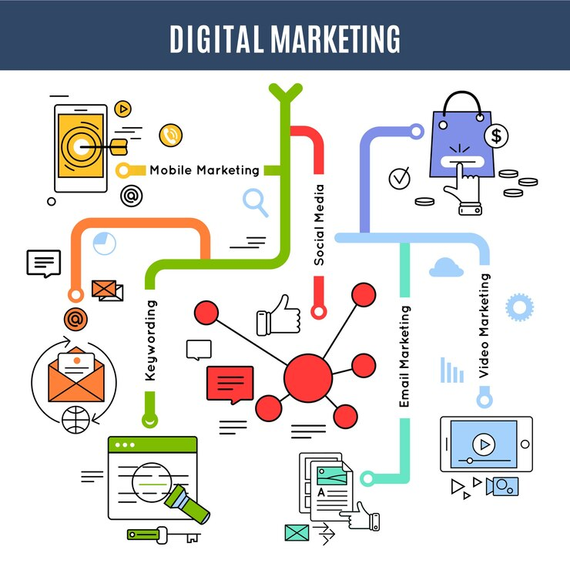
What are Digital Marketing Tools?
It can be challenging for small businesses to hire marketing help to plan, build, and implement a campaign.
Not only is it a hefty investment, but it may not be where you need to prioritize your hiring efforts or budget at the moment.
That's where digital marketing tools come in handy.
Digital marketing tools are apps that help you attract, engage, sell, and retain business online. They can help you with various aspects of marketing, such as social media, advertising, content creation, web design, analytics, and more.

Slide 4
What are Digital Marketing Tools?
Whether you're planning a campaign, creating digital assets for social media, or tracking your results, digital marketing tools will help make your efforts more efficient and convenient.
For example, you don't need to spend hours making a video with a tool like Adobe Spark or Animaker.
Digital marketing tools set you up for success and teach you along the way.

Slide 5
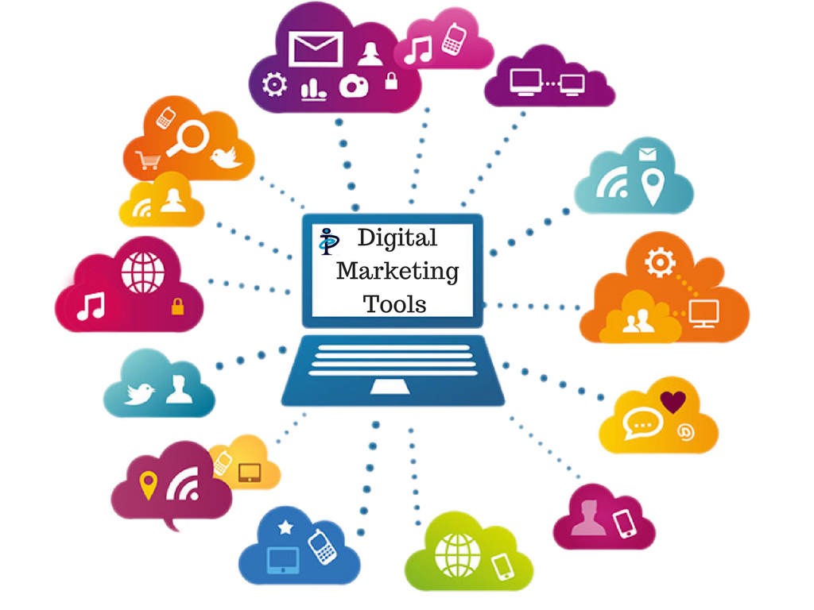
Why are Digital Marketing Tools Important?
Nowadays, consumers no longer want to be sold to, they want to be informed.
If you think that's only true for online shoppers, prepare to be surprised. Even when visiting a store in person, 83% of shoppers said they did some online research beforehand.
Digital marketing tools are essential to small businesses because they help build your online presence without hiring someone to do the work.
Even without a degree or any training, these tools fill in the gaps so you can plan, build, and implement your own campaigns.

Slide 6
Why are Digital Marketing Tools Important?
They help you reach a larger and more relevant audience, drive more sales and revenue, and measure and optimize your marketing performance.
Digital marketing tools help you reach people where they spend their time and money. The average Internet user has at least 8 social media accounts and spends over 2 hours a day on social media. By using tools like Sprout Social, Loomly, or Hootsuite, you can create and manage your social media content, engage with your audience, and monitor your social media performance.

Slide 7
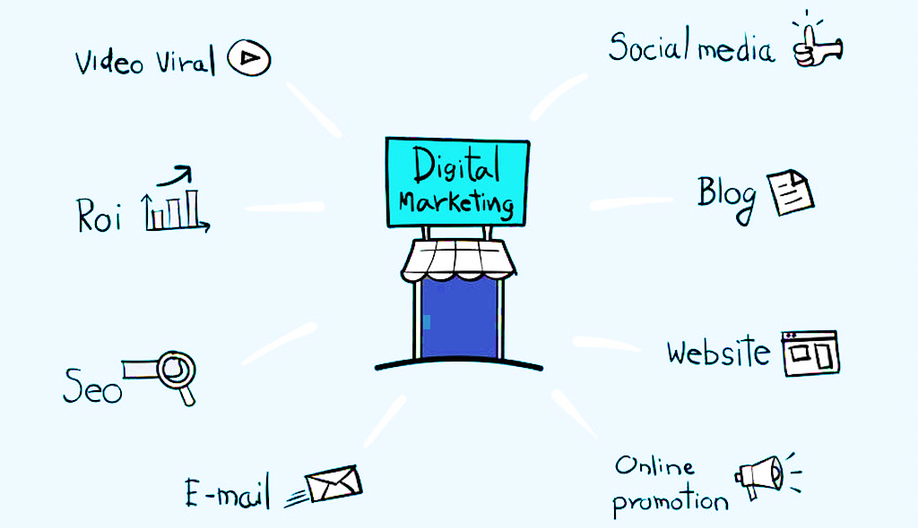
Why are Digital Marketing Tools Important?
Digital marketing tools help you target your ideal customers. Unlike traditional marketing methods that rely on mass communication, digital marketing tools allow you to segment and personalize your messages based on various criteria, such as demographics, interests, behaviour, location, and more. By using tools like Google Ads, Facebook Ads, or HubSpot, you can create and run targeted campaigns that reach the right people at the right time with the right offer.
Digital marketing tools help you measure your results and optimize your campaigns. One of the biggest advantages of digital marketing is that you can track and analyse your data in real time. By using tools like Google Analytics, Ahrefs, or Unbounce, you can see how your website, landing pages, ads, emails, and other digital channels are performing and identify what works and what doesn’t. You can also use tools like Google Bard or Jasper to generate creative content based on your data and insights.

Slide 8
Why are Digital Marketing Tools Important?
Digital marketing tools help you increase your conversion rate and customer loyalty. Digital marketing tools not only help you attract more visitors to your website but also help you convert them into leads and customers. By using tools like ChatGPT, Manychat, or Peech, you can create interactive and engaging experiences for your visitors, such as chatbots, videos, quizzes, and more. You can also use tools like ActiveCampaign, Klaviyo, or Benchmark Email to nurture your leads and customers with relevant and timely emails that build trust and loyalty.

Slide 9
Useful Digital Marketing Tools for Business
There are many useful and some free digital marketing tools for business that can help you with various aspects of marketing, such as social media, advertising, content creation, web design, analytics, and more. Here are some of the tools that you can use:
Canva: A graphic design platform that lets you create stunning visuals for your website and social media. You can use Canva to design logos, flyers, posters, infographics, banners, and more. You can also choose from thousands of templates and customize them with your own images, fonts, colours, and elements.

Slide 10
Useful Digital Marketing Tools for Business
DALL·E: An artificial intelligence model that can generate images from text prompts. You can use DALL·E to create unique and original images for your content, such as illustrations, icons, memes, and more. You can also experiment with different prompts and see what DALL·E comes up with.
Buffer: A social media management tool that helps you schedule posts, analyse performance, and engage with your audience. You can use Buffer to plan and publish your content across multiple social platforms, such as Facebook, Twitter, Instagram, LinkedIn, and more. You can also track your reach, impressions, clicks, likes, comments, and shares.

Slide 11
Useful Digital Marketing Tools for Business
Hootsuite: Another social media management tool that offers similar features as Buffer, plus more integrations and advanced analytics. You can use Hootsuite to manage your social media accounts from one dashboard, monitor your brand mentions and keywords, and generate reports and insights.
Zoom: A video conferencing tool that allows you to host webinars, meetings, and online events. You can use Zoom to connect with your customers, prospects, partners, and team members in real time. You can also share your screen, record your sessions, and chat with your participants.

Slide 12
Useful Digital Marketing Tools for Business
Livestorm: A webinar platform that helps you create engaging and interactive webinars with features like polls, chat, Q&A, and more. You can use Livestorm to host live or on-demand webinars for your audience. You can also integrate Livestorm with your email marketing tools and CRM tools to automate your webinar campaigns.
Peech: A video creation tool that uses AI to turn your text into professional-looking videos. You can use Peech to create videos for your website and social media in minutes. You can also choose from different styles, music, voiceovers, and animations.

Slide 13
Useful Digital Marketing Tools for Business
YouTube: The most popular video hosting and sharing platform in the world. You can use YouTube to upload your videos and reach a global audience. You can also monetize your videos with ads or memberships.
Wistia: A video hosting platform that offers more control and customization over your videos, as well as analytics and marketing features. You can use Wistia to embed your videos on your website and optimize them for SEO. You can also capture leads with forms or calls-to-action within your videos.

Slide 14
Useful Digital Marketing Tools for Business
Wix: A website builder that lets you create beautiful and responsive websites without coding. You can use Wix to design your website with drag-and-drop tools or choose from hundreds of templates. You can also add features like blogs, eCommerce stores, contact forms, and more.
Shopify: An eCommerce platform that helps you sell your products online with features like inventory management, payment processing, and marketing tools. You can use Shopify to create your online store and customize it with themes and apps. You can also integrate Shopify with other platforms like Facebook Shops or Instagram Shopping.

Slide 15
Useful Digital Marketing Tools for Business
Squareup: Another eCommerce platform that also offers point-of-sale solutions for brick-and-mortar businesses. You can use Squareup to accept payments online or in person with a card reader or a mobile device. You can also manage your inventory, invoices, receipts, and reports.
Carrd: A landing page builder that helps you create simple and attractive one-page websites. You can use Carrd to showcase your products or services or collect leads or feedback from your visitors. You can also choose from dozens of templates or start from scratch.

Slide 16
Useful Digital Marketing Tools for Business
Google Analytics gives you an overview of your website's traffic to gain insight into who is visiting your site and which strategies work best. Let's say you notice you're getting a lot of high-converting traffic from an Instagram campaign. You'll definitely want to spend more on Instagram ads instead of gambling on Facebook or Twitter. You don't need to know exactly what you're doing to get started, but the sooner you activate it, the better. It will immediately start collecting valuable information that you can use to your advantage.

Slide 17
Useful Digital Marketing Tools for Business
Ahrefs Free SEO Tools: A suite of free SEO tools that help you optimize your website for search engines, such as keyword research, site audit, rank tracker, and more.
ChatGPT: An AI chatbot that can converse with your customers in natural language and answer their queries.
Google Bard: Another AI chatbot that can also generate poems, stories, jokes, and other creative content based on your input.
Manychat: A chatbot builder that helps you create your own chatbots for various platforms, such as Facebook Messenger, WhatsApp, SMS, and email.

Slide 18
Useful Digital Marketing Tools for Business
Unbounce: A landing page builder that offers more features and flexibility than Carrd, such as A/B testing, popups, and sticky bars. You can use Unbounce to create high-converting landing pages for your campaigns. You can also optimize your pages for speed, SEO, and mobile devices.
Benchmark Email: An email marketing tool that helps you create and send beautiful newsletters to your subscribers.
Mailchimp: Another email marketing tool that offers more features and integrations than Benchmark Email.
ActiveCampaign: An email marketing tool that also offers CRM and marketing automation features to help you nurture your leads and customers.

Slide 19
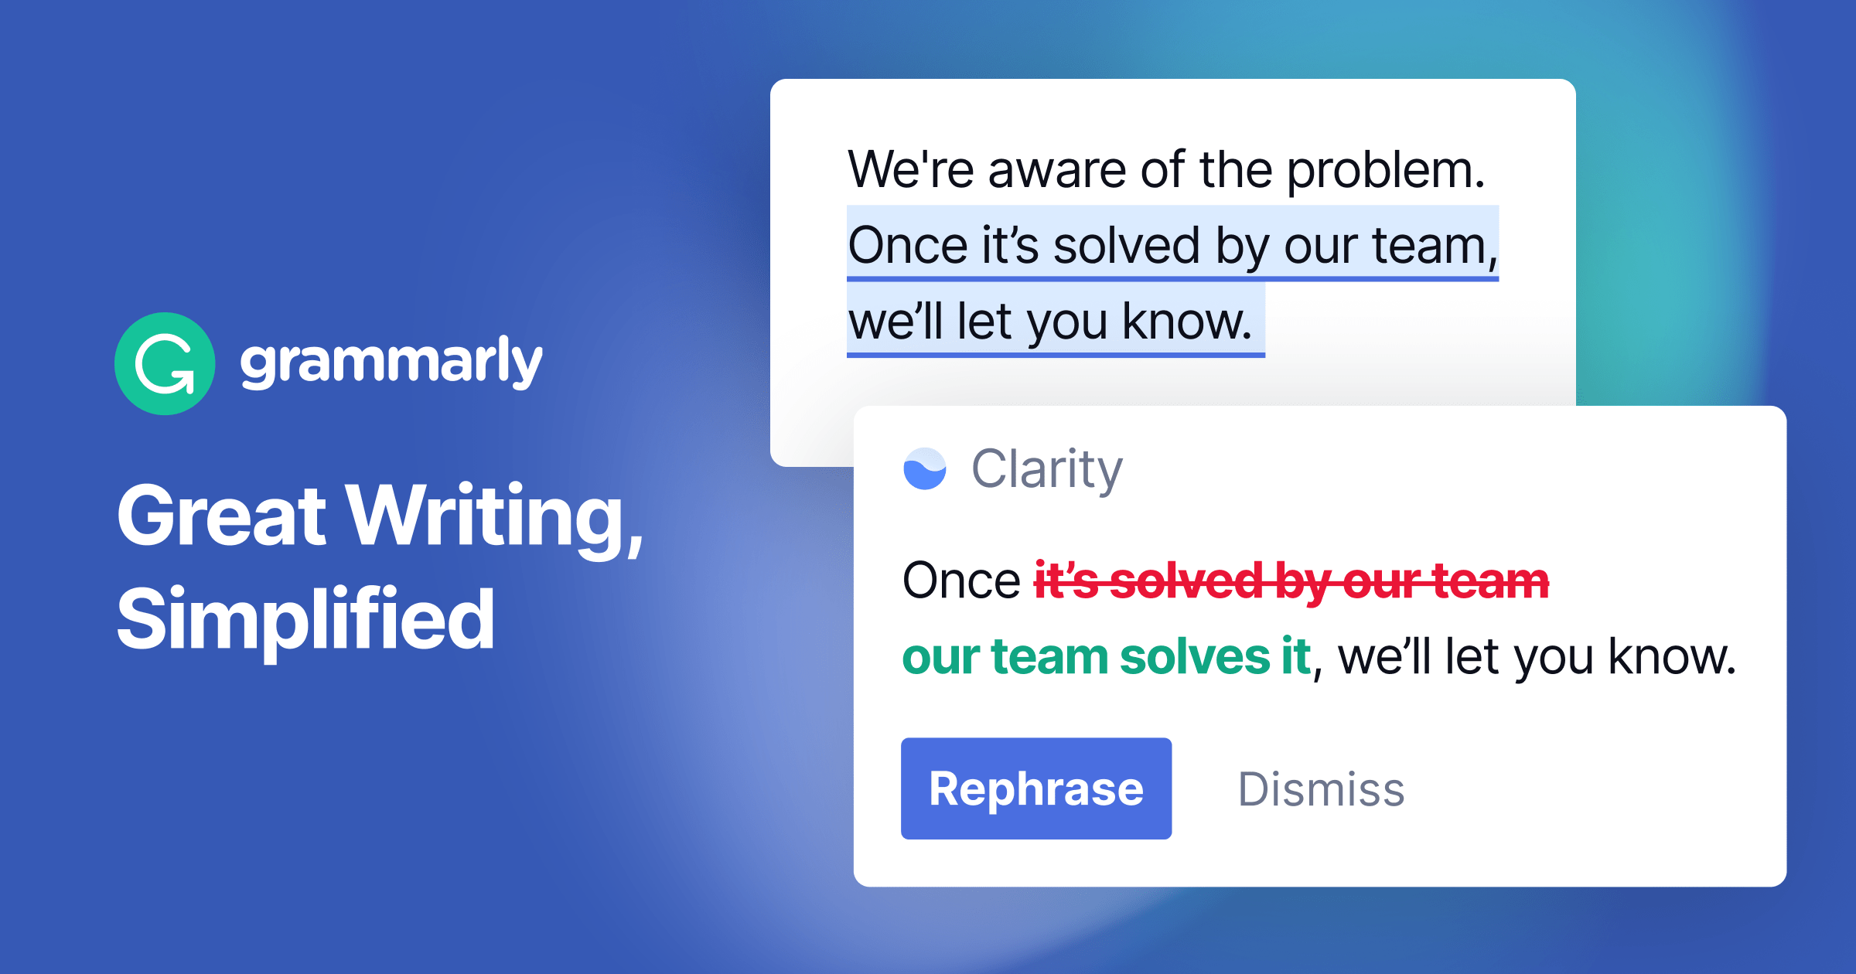
Useful Digital Marketing Tools for Business
Google Forms: A free online form builder that lets you create surveys, quizzes, feedback forms, and more.
Typeform: An online form builder that offers more interactivity and design options than Google Forms.
Jasper: An AI-powered content writing tool that helps you write blog posts, articles, emails, social media captions, and more.
Writesonic: Another AI-powered content writing tool that offers similar features as Jasper, plus more templates and integrations.
Grammarly: An AI-powered writing assistant that helps you improve your grammar, spelling, punctuation, tone, and clarity of your writing.

Slide 20
Useful Digital Marketing Tools for Business
KISSmetrics
FollowerWonk
All-in-One SEO Pack (for WordPress)
Crazy Egg
CoFoundersLab
Sprout Social
Loomly
Audiense
SendGrid
Lemlist
Moosend
Clearscope
SEMrush
Optimizely
Hotjar
Clearbit
Datanyze
OptiMonk
Creatopy
Visme
Venngage

Slide 21
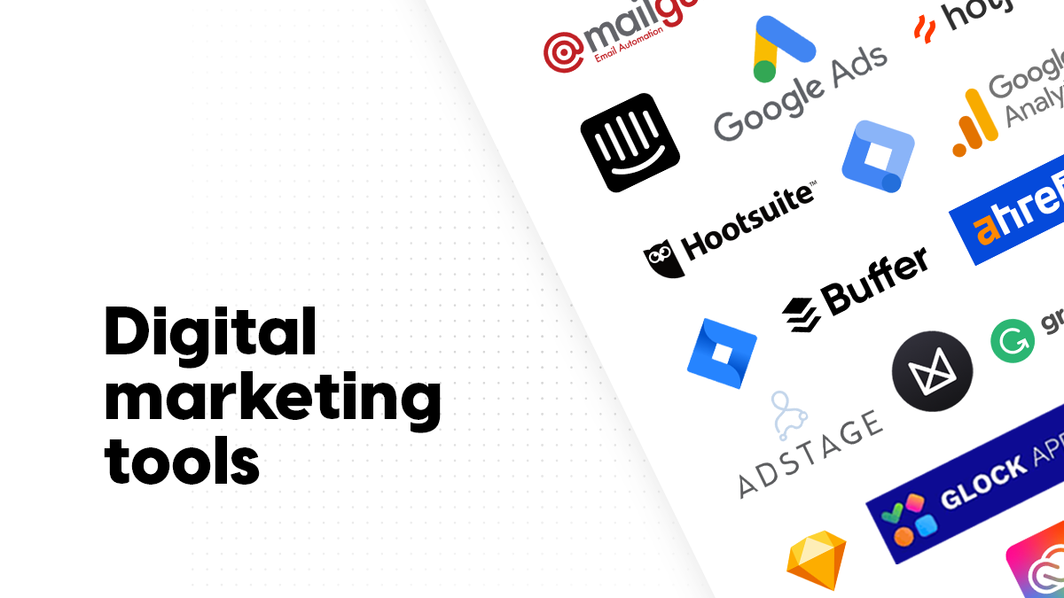
Activity
Check the different tools listed in this module and try the ones that interest you to create marketing materials of your choice.

Slide 22
Get Creative

