Slide 1
Marketing Essentials

Slide 2
Learning Outcomes
Importance of Marketing
Entrepreneurial Marketing and Marketing Mix
Market Research, Market Opportunity Recognition and Target Market
Marketing Techniques and Tools for Entrepreneurs
Entrepreneurial Branding
Marketing Strategy and Marketing Plan
Sales and Customer Service

Slide 3
Importance of Marketing
Knowing marketing can help entrepreneur’s like you achieve your business goals, reach your target customers, and create a competitive advantage in the market.
Marketing can help establish an online presence, which is crucial for reaching a large and diverse audience of potential customers. By using various online platforms and channels, such as websites, blogs, social media, email, and videos, you can communicate your brand identity, value proposition, and product benefits to your audience.
Marketing can help engage with your customers and build trust and loyalty. By creating and sharing valuable and relevant content, you can attract and retain customers who are interested in your products or services. Marketing can also help you collect feedback, respond to queries, and solve problems for your customers.
Marketing can help differentiate your products or services from your competitors and create a unique selling proposition. By conducting market research and analysis, you can identify the needs, preferences, and pain points of your customers and design products or services that meet or exceed your expectations. Marketing can also help position your products or services in a way that highlights your distinctiveness and value.

Slide 4
Importance of Marketing
Marketing can help you grow your sales and revenue by generating leads and conversions. By using various promotional strategies, such as advertising, public relations, events, referrals, and word-of-mouth, you can increase the awareness and interest of your products or services among potential customers. Marketing can also help you persuade and motivate customers to take action and buy your products or services.
Marketing can help you adapt to changing market conditions and customer demands by being flexible, agile, and creative. By monitoring and evaluating the performance of your marketing activities, you can learn from your successes and failures and make adjustments accordingly. Marketing can also help you identify new opportunities, develop new products or services, and enter new markets.
Marketing is a vital process for entrepreneurs like you because it can help you create value for your customers and achieve a sustainable competitive advantage in the market. By understanding the marketing essentials, you can develop and implement effective marketing strategies that suit your business objectives, resources, and capabilities.

Slide 5
Entrepreneurial Marketing and Marketing Mix
Entrepreneurial marketing is a set of unconventional practices that can help start-ups and younger firms emerge and have an edge in competitive markets. It differs from traditional marketing, which focuses on managing and growing existing programs and brands, by being more flexible, agile, and creative. Entrepreneurial marketing tends to focus on satisfying the customer and building trust by providing innovative products and services that disrupt or appeal to a specific market.
Some of the characteristics of entrepreneurial marketing are:
It is opportunity-driven, meaning that it seeks to identify and exploit gaps or niches in the market that are not served by existing competitors .
It is customer-centric, meaning that it puts the customer at the centre of its marketing activities and strives to understand and meet your needs, wants, and expectations .

Slide 6
Entrepreneurial Marketing and Marketing Mix
It is resourceful, meaning that it makes use of the available resources and capabilities of the firm and its network of partners, suppliers, investors, and other stakeholders .
It is innovative, meaning that it creates new or improved products or services that offer superior value or solve a problem for the customer .
It is risk-taking, meaning that it is willing to experiment with new ideas and approaches and learn from failures and feedback .
Entrepreneurial marketing is an integral part of any business strategy. It requires a proactive orientation, innovativeness, focus on customers, utilization of opportunity, risk management, and value creation in order for an interactive marketing approach to be successful.

Slide 7
Entrepreneurial Marketing and Marketing Mix
Entrepreneurial Marketing Mix is a term that refers to the marketing strategies and practices that are used by entrepreneurs to create and sustain a competitive advantage in the market. Entrepreneurial Marketing Mix differs from the traditional marketing mix in several ways, such as:
Product: Entrepreneurs often offer innovative products or services that disrupt the existing market or create new markets. They focus on satisfying the customer needs and wants, rather than following the industry standards or norms. Entrepreneurs also tend to customize their products or services to meet the specific preferences of their target segments.
For example, Airbnb offers a unique alternative to traditional hotels by allowing people to rent out their homes or rooms to traveller's.

Slide 8
Entrepreneurial Marketing and Marketing Mix
Price: Entrepreneurs often use pricing strategies that reflect the value proposition of their products or services, rather than the cost-based or competition-based pricing. They may charge a premium price for a high-quality or differentiated product or service, or a low price for a cost-effective or disruptive product or service. Entrepreneurs may also use dynamic pricing, which adjusts the price according to the demand and supply conditions, or value-based pricing, which sets the price based on the perceived value of the customer. For example, Uber uses dynamic pricing to match the supply and demand of drivers and riders.

Slide 9
Entrepreneurial Marketing and Marketing Mix
Place: Entrepreneurs often use unconventional or creative channels of distribution to reach their customers and deliver their products or services. They may leverage online platforms, social media, mobile apps, or word-of-mouth to create awareness and generate sales. They may also use direct selling, franchising, licensing, or partnering to expand their market coverage and reduce their distribution costs.
For example, Netflix uses online streaming to deliver its content to its subscribers.

Slide 10
Entrepreneurial Marketing and Marketing Mix
Promotion: Entrepreneurs often use guerrilla marketing, viral marketing, content marketing, or experiential marketing to promote their products or services. These are low-cost but high-impact methods that aim to create buzz, engagement, and loyalty among the customers. They may also use personal selling, referrals, testimonials, or endorsements to build trust and credibility among the customers. For example, Dropbox used a referral program that rewarded its users with free storage space for inviting their friends to join.
Entrepreneurial Marketing Mix is a flexible and adaptable approach that allows to respond quickly and effectively to the changing market conditions and customer preferences. It is based on the principles of creativity, innovation, experimentation, and customer orientation. It is suitable for start-ups and small businesses that operate in dynamic and uncertain environments.

Slide 11
Market Research, Market Opportunity Recognition and Target Market
Market research is a very important activity for entrepreneurs who want to launch a new product or service, or improve an existing one. Market research can help entrepreneurs to:
Identify the needs and preferences of your potential customers.
Evaluate the size and growth potential of your target market.
Assess the strengths and weaknesses of your competitors.
Determine the best pricing and distribution strategies.
Test and refine your product or service features and benefits.
Create effective marketing campaigns and messages

Slide 12
Market Research, Market Opportunity Recognition and Target Market
To conduct market research, you need to follow some basic steps:
Identify buyer persona: A buyer persona is a fictional representation of your ideal customer, based on data and assumptions. It helps you to understand who your target customers are, what they want, how they behave, and how they make decisions. You can create buyer personas by using online tools, conducting surveys, interviewing customers, or analysing existing data.
Find a sample: A sample is a group of people who represent your target market and who can provide feedback on your product or service. You can find a sample by using online platforms, social media, referrals, or existing customers. You should aim to have a sample that is large enough and diverse enough to reflect your target market.

Slide 13
Market Research, Market Opportunity Recognition and Target Market
Create research questions: Research questions are specific questions that you want to answer through your market research. You should be relevant, clear, and measurable. You can create research questions by using the SMART framework: Specific, Measurable, Achievable, Relevant, and Time-bound. For example, a research question could be: "How likely are customers to buy my product at a price of €10 within the next month?"
Assess your competition: Competition analysis is the process of identifying and evaluating your competitors in terms of your products, prices, strengths, weaknesses, opportunities, and threats. You can assess your competition by using online tools, visiting your websites, reading your reviews, or buying your products. You should aim to find out what makes your product or service unique and superior to your competitors.

Slide 14
Market Research, Market Opportunity Recognition and Target Market
Create a market research summary: A market research summary is a document that summarizes the main findings and insights from your market research. It should include the following sections: Introduction (the purpose and objectives of your market research), Methodology (the methods and tools you used to collect and analyse data), Results (the data and statistics you obtained from your sample), Analysis (the interpretation and explanation of your results), Recommendations (the actions and strategies you suggest based on your analysis), and Conclusion (the main takeaways and implications of your market research).
Market research is an essential tool for entrepreneurs who want to succeed in the market. By conducting market research, you can gain valuable insights into your customers, competitors, and industry, and use them to create a better product or service that meets the market demand.

Slide 15
Market Research, Market Opportunity Recognition and Target Market
Market Opportunity Recognition is the process of identifying and evaluating the potential of new or existing markets for a product or service. It involves analysing the market size, growth, trends, customer needs, competitors, and environmental factors that affect the market. Market Opportunity Recognition can help to:
Discover unmet or underserved customer needs that can be satisfied by a new or improved product or service.
Find gaps or niches in the market that are not well served by the existing competitors.
Exploit emerging trends or technologies that create new market opportunities or change the existing market dynamics.
Assess the feasibility and profitability of entering a new or existing market.
Develop a unique value proposition that differentiates the product or service from the competitors.
Create a marketing strategy that targets the most attractive segments of the market.

Slide 16
Market Research, Market Opportunity Recognition and Target Market
To conduct Market Opportunity Recognition, you need to follow some basic steps:
Define the problem or need: The first step is to identify a problem or need that customers have and that is not adequately solved by the current solutions in the market. This can be done by observing customers, conducting surveys, interviewing experts, or analysing secondary data.
Generate ideas: The next step is to generate possible ideas for products or services that can solve the problem or need. This can be done by brainstorming, using creativity techniques, researching best practices, or benchmarking competitors.

Slide 17
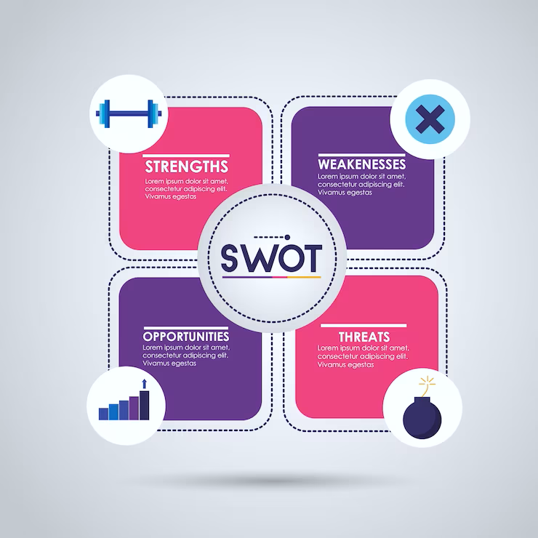
Market Research, Market Opportunity Recognition and Target Market
Evaluate ideas: The third step is to evaluate the ideas based on your feasibility, desirability, and viability. This can be done by using criteria such as customer value, market potential, competitive advantage, technical feasibility, financial viability, and social impact.
Select the best idea: The final step is to select the best idea that has the highest potential to succeed in the market. This can be done by using decision-making tools such as scoring models, decision matrices, or SWOT analysis.
Market Opportunity Recognition is also a critical skill for entrepreneurs who want to create and capture value in the market. By recognizing market opportunities, you can design products or services that meet customer needs and wants, and that have a competitive edge over the existing solutions.

Slide 18
Market Research, Market Opportunity Recognition and Target Market
A target market is a specific group of potential customers that a business aims to reach with its products or services. A target market is important because it helps to:
Understand the needs, preferences, and behaviours of your ideal customers.
Design and develop products or services that meet or exceed customer expectations.
Create and implement effective marketing strategies that attract and retain customers.
Achieve competitive advantage and profitability in the market.

Slide 19
Market Research, Market Opportunity Recognition and Target Market
To define a target market, you need to segment the market based on various criteria, such as:
Demographic: This refers to the basic characteristics of customers, such as age, gender, income, education, occupation, etc.
Geographic: This refers to the location of customers, such as country, region, city, neighbourhood, etc.
Psychographic: This refers to the lifestyle, personality, values, interests, and attitudes of customers.
Behavioural: This refers to the actions and reactions of customers, such as purchase patterns, usage frequency, loyalty, benefits sought, etc.

Slide 20
Market Research, Market Opportunity Recognition and Target Market
By segmenting the market, you can identify the most attractive and profitable segments that have a high demand for your products or services.
You can then tailor your products or services to fit the specific needs and wants of each segment. For example, an entrepreneur who wants to launch a new vegan restaurant can segment the market based on demographic (e.g., age group), geographic (e.g., city), psychographic (e.g., health-conscious), and behavioural (e.g., frequency of eating out) criteria.
You can then select the segment that has the most potential for their restaurant, such as young professionals who live in a metropolitan area and are interested in healthy and sustainable food options.

Slide 21
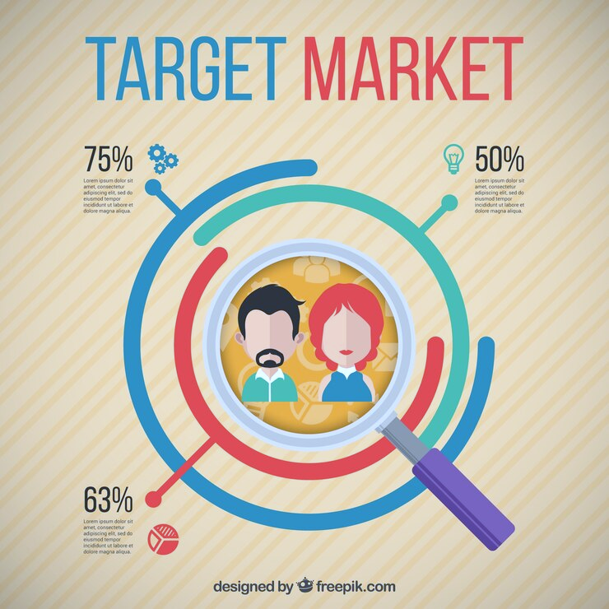
Market Research, Market Opportunity Recognition and Target Market
By defining a target market, you can also create a buyer persona, which is a fictional representation of your ideal customer. A buyer persona can help to:
Visualize and empathize with your target customers.
Communicate and connect with your target customers.
Develop and deliver value propositions that resonate with your target customers.
Measure and improve customer satisfaction and loyalty.

Slide 22
Market Research, Market Opportunity Recognition and Target Market
A buyer persona can include information such as name, age, occupation, goals, challenges, pain points, motivations, preferences, etc. For example, a buyer persona for the vegan restaurant could be:
Name: Anna
Age: 28
Occupation: Marketing manager
Goals: To advance her career and maintain a healthy lifestyle.
Challenges: To find time and money to eat well and exercise regularly.
Pain points: To deal with stress and fatigue from work and lack of nutritious food options.
Motivations: To enjoy delicious and affordable vegan food that supports her health and wellness goals.
Preferences: To order online or dine in at a cozy and friendly restaurant that offers a variety of vegan dishes.

Slide 23
Market Research, Market Opportunity Recognition and Target Market
By creating a buyer persona, you can better understand Anna’s needs and wants, and offer her a product or service that meets or exceeds her expectations.
In conclusion, a target market is a specific group of potential customers that a business aims to reach with its products or services. A target market is important because it helps to understand customers better and create products or services that satisfy them. To define a target market, you need to segment the market based on various criteria and create a buyer persona that represents your ideal customer.

Slide 24
Marketing Techniques and Tools for Entrepreneurs
Marketing techniques and tools are methods and resources that you can use to promote your products or services, attract customers, and increase sales. There are many different types of marketing techniques and tools, depending on the goals, target audience, budget, and industry of the entrepreneur. Some of the most common and effective marketing techniques and tools are:
Social media marketing: This involves using platforms like Facebook, Twitter, Instagram, LinkedIn, YouTube, and others to create and share content that engages potential and existing customers, builds brand awareness, and drives traffic to the website or landing page. Social media marketing can also include paid advertising, influencer marketing, user-generated content, and social listening.
Email marketing: This is one of the oldest and most reliable forms of digital marketing, which involves sending personalized and relevant messages to subscribers via email. Email marketing can help you communicate with your audience, nurture leads, increase conversions, and retain customers. Email marketing tools like Mailchimp, HubSpot, Constant Contact, and others can help you create, manage, and optimize your email campaigns.

Slide 25
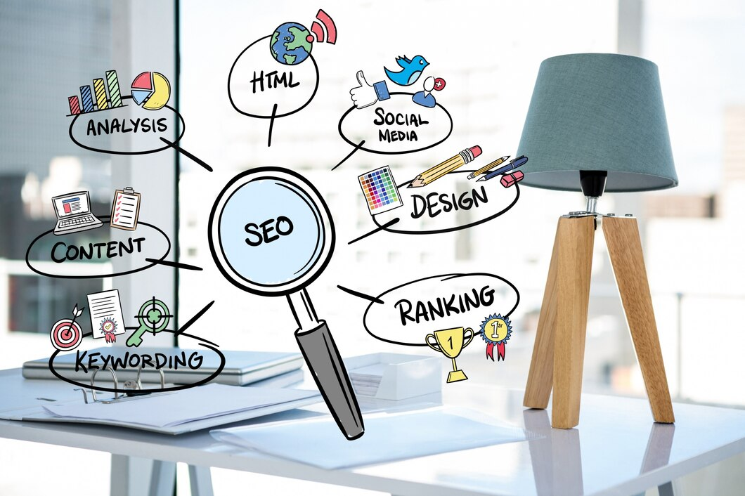
Marketing Techniques and Tools for Entrepreneurs
SEO (search engine optimization): This is the process of improving the visibility and ranking of a website or web page on search engines like Google or Bing. SEO involves optimizing the content, design, structure, and technical aspects of a website or web page to match the search intent and preferences of the target audience. SEO tools like Moz, Ahrefs, SEMrush, and others can help you conduct keyword research, analyse competitors, audit your website, and track your performance.
Conversion optimization: This is the process of increasing the percentage of visitors who take a desired action on a website or web page, such as signing up for a newsletter, downloading a resource, making a purchase, or filling out a form. Conversion optimization involves testing and improving various elements of a website or web page, such as headlines, copy, images, layout, colours, buttons, and others. Conversion optimization tools like Google Optimize, Unbounce, Hotjar, and others can help you run experiments, collect feedback, and analyse user behaviour.

Slide 26
Marketing Techniques and Tools for Entrepreneurs
Lead enrichment: This is the process of enhancing the quality and quantity of information about leads or prospects. Lead enrichment can help you segment your audience, personalize your messages, qualify your leads, and increase your sales efficiency. Lead enrichment tools like Clearbit, ZoomInfo, Leadfeeder, and others can help you find and verify contact information, enrich lead profiles with demographic and firmographic data, and integrate with CRM systems.
Landing page and lead capture: This is the process of creating and optimizing web pages that are designed to capture leads or prospects. Landing pages are usually focused on a specific offer or value proposition that entices visitors to provide your contact information in exchange for something of value. Lead capture tools like Leadpages.

Slide 27
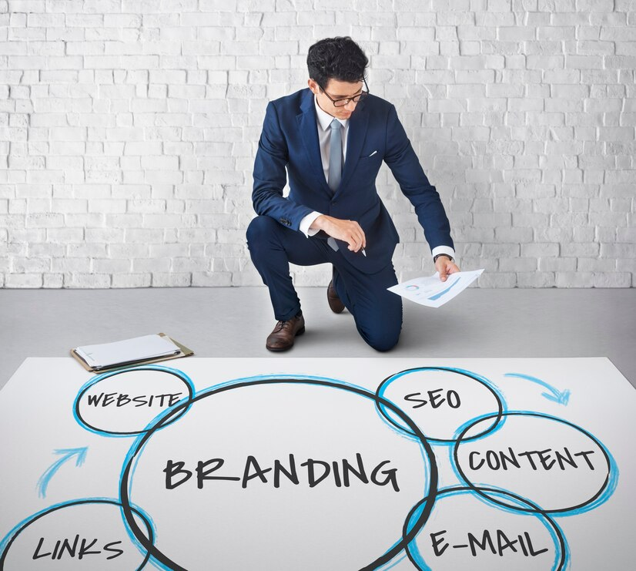
Entrepreneurial Branding
Entrepreneurial branding is the process of creating and communicating a unique and distinctive identity for a new or existing business. Entrepreneurial branding involves understanding the needs, preferences, and emotions of the target market, and developing a value proposition that resonates with them. Entrepreneurial branding also requires creativity, innovation, and risk-taking, as entrepreneurs often have to differentiate themselves from established competitors or create new markets. Entrepreneurial branding can help you attract customers, investors, partners, and employees, and build trust, loyalty, and reputation.

Slide 28
Entrepreneurial Branding
Some of the steps involved in entrepreneurial branding are:
Defining the vision, mission, values, and goals of the business.
Conducting market research and competitor analysis.
Identifying the target audience and your pain points.
Crafting a unique selling proposition (USP) and a brand promise.
Choosing a brand name, logo, tagline, and colour scheme.
Developing a brand voice and personality.
Creating a brand style guide and a brand story.
Designing and launching a website, social media profiles, and other marketing materials.
Measuring and monitoring the brand performance and feedback.

Slide 29
Marketing Strategy and Marketing Plan
A marketing strategy and a marketing plan are two related but different concepts that help a business achieve its marketing goals. A marketing strategy is the overall approach and direction for marketing a brand, product, or service to a target audience. A marketing plan is the detailed roadmap and action plan for implementing the marketing strategy.

Slide 30
Marketing Strategy and Marketing Plan
A marketing strategy covers the following aspects:
The vision, mission, values, and goals of the business.
The market research and competitor analysis.
The target audience and your needs, preferences, and pain points.
The unique selling proposition (USP) and the brand promise.
The positioning and differentiation of the brand, product, or service.
The key performance indicators (KPIs) and metrics to measure success.

Slide 31
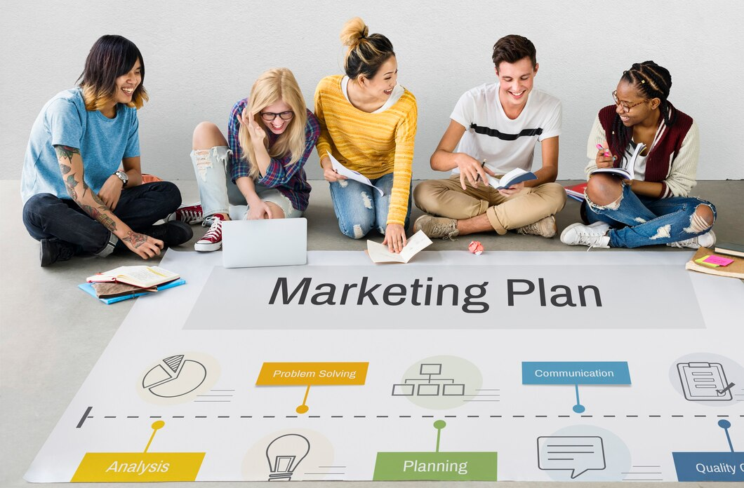
Marketing Strategy and Marketing Plan
A marketing plan covers the following aspects:
The channel strategy, content strategy, budget, campaign goals, key milestones, and dates to track.
The activities and tasks needed for execution.
The tools and resources required for each activity and task.
The roles and responsibilities of each team member involved.
The testing and optimization methods to improve results.

Slide 32
Marketing Strategy and Marketing Plan
A marketing strategy and a marketing plan are both essential for a successful marketing campaign. A marketing strategy provides the foundation and direction for the marketing efforts, while a marketing plan provides the specifics and details for the execution. A marketing strategy and a marketing plan should be aligned and consistent with each other, as well as with the overall business objectives.

Slide 33
Sales and Customer Service
Sales and customer service are two important aspects of running a successful business, especially for entrepreneurs who want to create loyal and satisfied customers. Sales and customer service can work together to provide a seamless and positive experience for the customers, from the first contact to the after-sales support. Here are some of the ways that sales and customer service can collaborate and benefit each other:
Sales can provide customer service with valuable information about the customers’ needs, preferences, pain points, and expectations, which can help customer service tailor your solutions and responses accordingly. Customer service can also give feedback to sales about the customers’ satisfaction, complaints, or suggestions, which can help sales improve your offerings and pitches.

Slide 34
Sales and Customer Service
Sales can leverage customer service as a source of referrals and testimonials, which can boost your credibility and trustworthiness in the eyes of potential customers. Customer service can also help sales by upselling or cross-selling additional products or services that can enhance the customers’ value and satisfaction.
Sales and customer service can share best practices, tools, and resources that can help them perform your tasks more effectively and efficiently. For example, you can use a CRM system to store and access customer data, a chatbot to automate responses to common queries, or a survey tool to collect feedback from customers.
Sales and customer service can align your goals and metrics to ensure that they are working towards the same vision and mission of the business. You can also communicate regularly and openly to resolve any issues or conflicts that may arise, and to celebrate your achievements and successes.

Slide 35
Start Marketing

