Slide 1
e-Commerce Essentials

Slide 2
Learning Outputs
e-Commerce Basics
e-Commerce Market Research
e-Commerce Platforms
e-Commerce Products
e-Commerce Marketing
e-Commerce Operations

Slide 3
e-Commerce Basics
What is e-Commerce?
e-Commerce is the activity of buying and selling goods and services over the internet, using various devices such as computers, tablets, smartphones, and smartwatches.
e-Commerce has many benefits for both consumers and businesses, such as convenience, cost-effectiveness, variety, and personalization. However, e-commerce also faces many challenges, such as security, competition, customer satisfaction, and cart abandonment.

Slide 4
e-Commerce Basics
The history of e-commerce can be traced back to the 1960s, when businesses used electronic systems to exchange data and documents.
The first online transaction was made in 1994, when a CD was sold through a website. Since then, e-commerce has grown rapidly with the development of the internet, web browsers, online platforms, payment systems, and mobile devices.
Today, e-commerce is a global phenomenon that encompasses many types of business models and market segments.

Slide 5
e-Commerce Basics
The common types of e-commerce:
Business-to-consumer (B2C): This is the most popular type of e-commerce, where businesses sell directly to consumers through online stores or marketplaces. Examples of B2C e-commerce are Amazon, eBay, Walmart, and Netflix.
Business-to-business (B2B): This is the type of e-commerce where businesses sell products or services to other businesses. Examples of B2B e-commerce are Alibaba, Shopify, Salesforce, and Microsoft.
Consumer-to-consumer (C2C): This is the type of e-commerce where consumers sell goods or services to other consumers through online platforms or social media. Examples of C2C e-commerce are Etsy, Craigslist, Facebook Marketplace, and Airbnb.
Consumer-to-business (C2B): This is the type of e-commerce where consumers offer their products or services to businesses through online platforms or social media. Examples of C2B e-commerce are Fiverr, Upwork, YouTube, and Instagram.

Slide 6
e-Commerce Basics
Benefits of e-commerce:
Lower costs: e-Commerce reduces the expenses of running a physical store, such as rent, utilities, staff, and inventory. e-Commerce also enables businesses to reach more customers with less marketing costs.
24/7 availability: e-Commerce allows customers to shop anytime and anywhere they want, without being limited by store hours or location. e-Commerce also enables businesses to operate around the clock and across different time zones.
Increased customer base: e-Commerce expands the potential market for businesses by allowing them to sell to customers from different regions and countries. e-Commerce also helps businesses to target specific segments of customers based on their preferences and behaviour.
Customer data collection: e-Commerce enables businesses to collect and analyse customer data, such as browsing history, purchase history, feedback, and reviews. This helps businesses to understand their customers better and offer them personalized recommendations and offers.
Preferred method of shopping: e-Commerce is becoming the preferred method of shopping for many customers who value convenience, speed, variety, and price comparison. e-Commerce also offers customers more options, choices, and customized products.

Slide 7
e-Commerce Basics
The challenges of e-commerce:
Cybersecurity: e-Commerce involves the exchange of sensitive information and money over the internet, which makes it vulnerable to cyberattacks and fraud. e-Commerce businesses need to ensure the security and privacy of their websites, platforms, payment systems, and customer data.
Competition: e-Commerce is a highly competitive industry with many players offering similar products or services. e-Commerce businesses need to differentiate themselves from their rivals by offering unique value propositions, quality products or services, competitive prices, and excellent customer service.
Customer satisfaction: e-Commerce relies on customer trust and loyalty to sustain and grow its business. e-Commerce businesses need to meet or exceed customer expectations by delivering high-quality products or services, fast and reliable shipping, easy returns and refunds, and responsive customer support.
Cart abandonment: Cart abandonment is a common problem in e-commerce where customers add items to their online shopping carts but do not complete their purchases. e-Commerce businesses need to reduce cart abandonment by optimizing their checkout process, offering free or discounted shipping, providing multiple payment options, and sending cart recovery emails.

Slide 8
e-Commerce Basics
To start an e-commerce business, you will need to follow these steps:
Research your market and decide what to sell. You should choose a product or service that has a high demand and low competition, and that matches your skills and interests. You should also identify your target audience and their needs and preferences.
Choose a business name and register your company. You should pick a name that is catchy, memorable, and relevant to your niche.
Create an e-commerce website or app. You can create your own or use the platforms.
Find reliable suppliers and vendors. You should source your products or services from suppliers or vendors that offer high-quality, low-cost, and fast delivery options. You should also establish a good relationship with them and negotiate the best terms and prices.
Promote your e-commerce business. You should use various digital marketing strategies to attract and retain customers, such as social media, email marketing, content marketing, influencer marketing, and paid advertising. You should also provide excellent customer service and encourage feedback and referrals.
Measure and improve your performance. You should use analytics tools to track and analyse your e-commerce metrics, such as traffic, conversion, revenue, retention, and customer satisfaction.

Slide 9
e-Commerce Market Research
Market research is a very important step before starting an e-commerce business. It can help you to:
Identify your target market and understand their needs, preferences, and behaviour.
Tailor your marketing strategy or product launch to fit your market and customer expectations.
Choose the best channels to market your business, such as social media, email, or paid ads.
Understand the competitive landscape and how to differentiate yourself from other e-commerce businesses.
Formulate an effective pricing strategy that balances profitability and customer value.
Identify your unique selling proposition (USP) that makes your e-commerce business stand out from the crowd.

Slide 10
e-Commerce Market Research
There are many ways to conduct market research for e-commerce, such as:
Doing online surveys or focus groups with potential customers or existing customers.
Analysing data from your website, social media, or other online platforms using tools like Google Analytics or Similarweb.
Studying the best practices and trends of successful e-commerce businesses in your niche or industry.
Reading online reviews, blogs, forums, or news articles about your product or service category.
Testing your product or service with a small group of customers before launching it to the public.

Slide 11
e-Commerce Market Research
To help you with your market research, here are some useful web resources that you can check out:
How to Do Market Research Before Starting a Business: This article provides a guide and template for conducting market research for any type of business, including e-commerce.
How to Do Market Research: A Guide and Template: This article explains the different types of market research, how to conduct them, and how to use them in your marketing strategy.
eCommerce Market Research: Entering a New Market: This article offers a comprehensive guide on how to conduct market research for e-commerce when entering a new market or expanding your business.
How to start an ecommerce business: Key steps: This article outlines the key steps to start an e-commerce business, from choosing your business model and value delivery method to building your online shop.

Slide 12
e-Commerce Platforms
There are different options for creating and hosting an online store, depending on your budget, skills, and preferences. Here are some of the most common ones:
An ecommerce website builder: This is an online software that lets you build your own online store without needing advanced tech skills or coding knowledge. You can choose from a variety of templates, customize your design, add your products, and connect to payment and shipping providers. Some examples of ecommerce website builders are Wix, Shopify, and Squarespace.
WordPress with an ecommerce plugin: WordPress is a popular content management system that powers over 40% of the web. You can use WordPress to create an online store by installing an ecommerce plugin, such as WooCommerce, that adds the necessary features and functionality to your site. You will need to get your own hosting and domain name, and have more control over the design and performance of your site.
A hosted ecommerce platform: This is a service that provides you with everything you need to run an online store, such as hosting, domain name, design, security, payment processing, and customer support. You don’t have to worry about the technical aspects of running your site, but you will have less flexibility and customization options.

Slide 13
e-Commerce Platforms
Here are some popular options for creating and hosting an online store, each with its own features, costs, and pros and cons.
Shopify: A complete e-commerce site builder that allows you to create and manage your online store with ease.
Shopify offers various plans starting from $29 per month, and provides features such as a drag-and-drop website builder, a large selection of themes and apps, a secure shopping cart, and multiple payment gateways.
Shopify also supports multichannel sales, meaning you can sell your products on platforms like Facebook, Instagram, Amazon, and eBay.
However, Shopify charges transaction fees ranging from 0% to 2% if you use a third-party payment processor instead of Shopify Payments. Shopify is best for dropshipping, print on demand, small stores, boutiques, and brick and mortar businesses that want to sell online.

Slide 14
e-Commerce Platforms
WooCommerce: A free and open-source plugin that turns your WordPress site into a fully functional e-commerce store. WooCommerce is ideal for content-driven brands, small to medium-sized businesses, and anyone who wants to customize their online store with thousands of plugins and extensions.
WooCommerce also integrates with many payment gateways, shipping providers, and marketing tools.
However, WooCommerce requires you to have your own domain name and web hosting, which can add to the cost and complexity of running your online store.
WooCommerce also has a steeper learning curve than some other platforms, and may require some technical skills to set up and maintain.

Slide 15
e-Commerce Platforms
Magento: A powerful and flexible e-commerce platform that is used by many large and enterprise-level businesses. Magento is also open-source, meaning you can modify the code and add features to suit your needs.
Magento offers a free Community Edition for small businesses, and a paid Enterprise Edition for larger businesses that need more scalability, security, and support. Magento has a rich set of features, such as product management, inventory management, order management, customer service, marketing tools, and analytics.
Magento also supports multilingual and multi-currency stores, as well as multiple websites and stores under one account.
However, Magento is not very user-friendly for beginners, and requires a lot of technical expertise and resources to run smoothly. Magento also has high hosting costs and development costs compared to some other platforms.

Slide 16
e-Commerce Platforms
There are many other platforms that cater to different niches and needs, such as
Squarespace
BigCommerce
Wix
PrestaShop
Big Cartel
Shift4Shop, etc.
Each platform has its own features, costs, pros and cons that you should consider before choosing one for your online business. You can use the links provided to learn more about each platform and compare them in detail.

Slide 17
e-Commerce Products
Finding, sourcing, and selling products online is a complex process that involves many steps and decisions. Here is a brief overview of how to do it, based on the web search results I found:
Finding a product to sell online: The first step is to find a product idea that has a high demand, low competition, and good profit margin. You can use various methods to generate product ideas, such as solving a problem, following your passion, researching trends, spying on competitors, or browsing online marketplaces. You can also use tools like Google Trends, Keyword Planner, or Amazon Best Sellers to validate your product idea and see how popular and profitable it is.

Slide 18
e-Commerce Products
Sourcing a product online: The next step is to find a supplier who can provide you with the product you want to sell. You can choose from different product sourcing strategies, such as drop shipping, print on demand, wholesale, or manufacturing. Each strategy has its own pros and cons, depending on your budget, time, resources, and preferences. You can use various product sourcing websites and apps to find and connect with suppliers, such as Alibaba, IndiaMart, Made-In-China, DSers, Printify, Printful, Dripshipper, Creative Hub, or Lulu Xpress.

Slide 19
e-Commerce Products
Selling a product online: The final step is to create an online store and market your product to your target audience. You can use an all-in-one platform like Shopify to create a professional and user-friendly online store with features such as product catalogue, shopping cart, checkout, payment processing, order tracking, and customer support. You can also use various digital marketing strategies to attract and retain customers, such as social media, email marketing, content marketing, influencer marketing, and paid advertising. You can also use analytics tools to track and analyse your ecommerce metrics, such as traffic, conversion, revenue, retention, and customer satisfaction.

Slide 20
e-Commerce Products
Drop shipping, print on demand, and other methods are different ways to fulfil orders for your online store without having to handle the inventory, packaging, or shipping yourself. Here is a brief overview of how to use each method:
Drop shipping: This is when you partner with a supplier who will produce and ship the products to your customers on your behalf. You only pay for the products that you sell, and you don’t have to worry about managing the stock or logistics. To use drop shipping, you need to find a reliable and reputable supplier who offers the products that you want to sell, and connect your store to their platform using an app or plugin. You can then add the products to your store and set your own prices and margins. When a customer places an order, the supplier will receive the order details and fulfil it for you. You can track the order status and communicate with the supplier if needed

Slide 21
e-Commerce Products
Print on demand: This is when you create your own designs for products such as t-shirts, mugs, posters, etc., and use a supplier who will print and ship them to your customers on demand. You don’t have to buy or store any inventory, and you can offer unique and customized products to your customers. To use print on demand, you need to find a supplier who offers the products that you want to design, and connect your store to their platform using an app or plugin. You can then upload your designs to their platform and add the products to your store. You can also set your own prices and margins. When a customer places an order, the supplier will print and ship the product for you. You can track the order status and communicate with the supplier if needed.

Slide 22
e-Commerce Products
Other methods: There are also other methods to fulfil orders for your online store, such as using a third-party fulfilment service, outsourcing to a local manufacturer, or doing it yourself. Each method has its own advantages and disadvantages, depending on your budget, time, resources, and preferences. You should compare the different options and choose the one that suits your business goals and needs best.

Slide 23
e-Commerce Marketing
Promoting and selling products online is a challenging task that requires a combination of different channels and strategies. Here are some of the most effective ways to do it, based on the web search results I found:
SEO (Search Engine Optimization): This is the process of improving your website’s visibility and relevance on search engines like Google or Bing. SEO involves optimizing your site’s content, structure, speed, and user experience to match the keywords and intent of your potential customers. SEO can help you drive organic traffic to your site, which can lead to more conversions and sales.

Slide 24
e-Commerce Marketing
Social media: This is a powerful way to connect with your audience, build brand awareness, and showcase your products. Social media platforms like Instagram, TikTok, Facebook, and Pinterest allow you to sell products directly to customers through features like shoppable posts, stories, and live videos. You can also use social media to engage with your followers, share valuable content, and create a loyal community around your brand.
Email marketing: This is one of the most effective and cost-efficient digital marketing strategies. Email marketing allows you to communicate with your subscribers in a personalized and timely manner. You can use email marketing to promote your products, offer discounts, share customer testimonials, and encourage repeat purchases. Email marketing can also help you build trust and loyalty with your customers, as well as increase your retention and referral rates.

Slide 25
e-Commerce Marketing
Content marketing: This is the creation and distribution of valuable and relevant content that attracts, educates, and entertains your target audience. Content marketing can help you establish your authority and credibility in your niche, as well as generate leads and sales. Content marketing can include various formats such as blog posts, eBooks, videos, podcasts, infographics, webinars, and more. The key is to provide useful and engaging content that solves your customers’ problems and answers their questions.
Influencer marketing: This is a form of word-of-mouth marketing that leverages the power and reach of influential people in your industry or niche. Influencer marketing can help you increase your brand awareness, credibility, and trust among your target audience. You can collaborate with influencers to create sponsored posts, reviews, tutorials, giveaways, or other types of content that feature your products. Influencer marketing can also help you drive traffic to your website or social media channels, as well as generate sales through affiliate links or discount codes.

Slide 26
e-Commerce Marketing
These are some of the most important digital marketing strategies that can help you promote and sell products online. However, you should not rely on just one or two channels or strategies. Instead, you should create a comprehensive digital marketing strategy that integrates multiple channels and strategies to reach and convert your ideal customers. You should also test and measure the performance of each channel and strategy to optimize your results and ROI.

Slide 27
e-Commerce Marketing
It is important to measure and optimize the performance of marketing campaigns for e-commerce, here are some general steps and tips that might help:
Make sure your site is ready for the traffic and conversions that you expect from your campaigns. This means having a fast, secure, mobile-friendly, and user-friendly site that offers a great shopping experience. You can use tools like Google PageSpeed Insights, Google Analytics, and Shopify to check your site’s performance and identify areas for improvement.
Set real and SMART (Specific, Measurable, Achievable, Relevant, and Time-bound) goals for your campaigns. For example, instead of saying “I want to increase sales”, say “I want to increase sales by 10% in the next quarter”. Having clear and realistic goals will help you track your progress and evaluate your success.

Slide 28
e-Commerce Marketing
Define your target customer and create buyer personas that represent their demographics, psychographics, behaviour, needs, and pain points. This will help you tailor your campaigns to the right audience and deliver relevant and personalized messages that resonate with them.
Define your value propositions and unique selling points that differentiate your brand and products from your competitors. This will help you communicate the benefits and value of your offerings to your potential customers and persuade them to buy from you.

Slide 29
e-Commerce Marketing
Find the right channels for your target customer and budget. There are many online marketing channels that you can use to reach your audience, such as email, social media, search engines, display ads, video ads, influencer marketing, content marketing, etc. You need to research which channels are most effective for your niche, industry, and goals, and allocate your budget accordingly.
Write ad copy that converts. Your ad copy should be clear, concise, catchy, and compelling. It should capture the attention of your audience, address their pain points or desires, highlight your value propositions or offers, and include a strong call-to-action that urges them to take the next step.

Slide 30
e-Commerce Marketing
Optimize your campaign performance based on data and feedback. You need to monitor and measure your campaign metrics and KPIs regularly to see how they are performing against your goals. Some common ecommerce metrics include traffic, bounce rate, conversion rate, average order value, customer lifetime value, return on ad spend (ROAS), etc. You also need to collect feedback from your customers through surveys, reviews, testimonials, etc. Based on the data and feedback, you can identify what’s working well and what needs improvement. You can then test different variables such as ad copy, images, headlines, landing pages, offers, etc. to find the optimal combination that maximizes your results.

Slide 31
e-Commerce Operations
Managing and running an online store efficiently and effectively requires some specific considerations, such as the local market conditions, customer preferences, legal regulations, and tax obligations. Here are some aspects that you should pay attention to:
Inventory management: Depending on your business model and product type, you may need to source and store your products locally or internationally. If you source your products from abroad, you should be aware of the customs duties, import taxes, and shipping costs that may apply. You should also consider the delivery time and reliability of your suppliers. If you store your products locally, you should find a suitable warehouse or storage facility that meets your needs and budget. You should also use inventory management software or tools to keep track of your stock levels, avoid overstocking or stockouts, and automate your order fulfilment process.

Slide 32
e-Commerce Operations
Order fulfilment: You should choose the best order fulfilment method for your online store, whether you handle it yourself, outsource it to a third-party service, or use a drop shipping model. Each method has its own advantages and disadvantages, depending on your product type, target market, and customer expectations. You should compare the costs, speed, quality, and customer service of each option and find the one that suits your business goals and needs best. You should also monitor your order fulfilment performance and track your orders from start to finish

Slide 33
e-Commerce Operations
Shipping and delivery: You should offer various shipping and delivery options to your customers, such as standard shipping, express shipping, free shipping, flat rate shipping, or local pickup. You should also choose the best shipping carrier and service for your online store, considering factors like shipping speed, cost, reliability, tracking, insurance, and customer service. You should also optimize your packaging and labelling to reduce shipping costs and errors, protect your products from damage or theft, and enhance your brand image

Slide 34
e-Commerce Operations
Customer service: You should provide excellent customer service to your customers before, during, and after their purchase. You should communicate with your customers through various channels, such as email, phone call, chatbot , social media , or live chat . You should also respond to their inquiries , complaints , feedback , or reviews promptly , politely , professionally , and empathetically . You should also offer various customer service options to your customers , such as self-service , FAQs , return policy , refund policy , warranty policy , or loyalty program . You should also measure your customer service performance , using metrics like customer satisfaction score , net promoter score , customer effort score , first response time , resolution time , or customer retention rate.

Slide 35
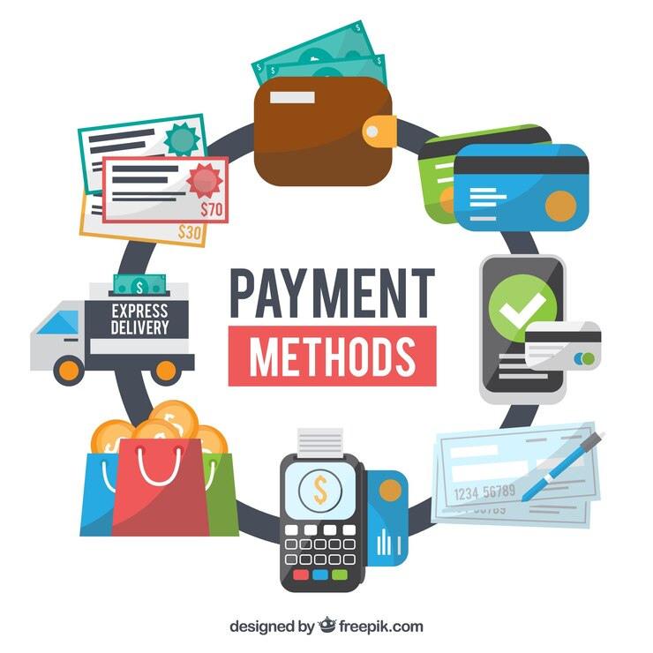
e-Commerce Operations
Payment processing: You should offer various payment methods to your customers, such as credit card , debit card , PayPal , Apple Pay , Google Pay , or cryptocurrency . You should also choose the best payment gateway for your online store, considering factors like fees , features , security , reliability , compatibility , and customer preference . You should also optimize your checkout process to reduce cart abandonment , increase conversion rate , and enhance customer experience

Slide 36
e-Commerce Operations
Taxes and legal issues: You should comply with the tax laws and regulations for your online store. You should register your business with the relevant authorities and obtain a VAT number if applicable. You should also collect and remit VAT from your customers if applicable. You should also comply with the ecommerce laws and regulations for your online store. These may include consumer protection laws , privacy laws , data protection laws , intellectual property laws , or trade laws . You should also create and display various legal documents on your website or app . These may include terms of service , privacy policy , refund policy , disclaimer , or cookie policy.

Slide 37
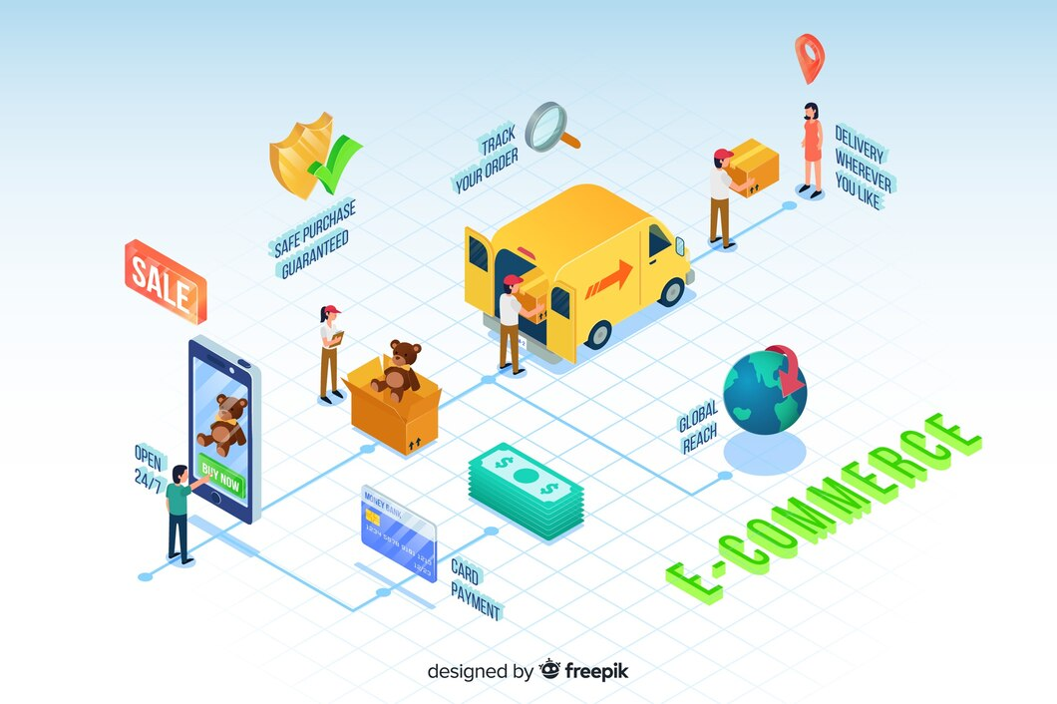
e-Commerce Operations
However, you should also keep in mind that ecommerce is a dynamic and competitive industry that requires constant learning, testing, and improvement. You should always monitor your ecommerce performance, analyse your data, and optimize your strategies to achieve your business goals and satisfy your customers.

Slide 38
Get Clicking…

