Slide 1
Commercialization
How to obtain the funding sources for commercialization of your business idea

Slide 2
Outline
Business start-up and development
Funding sources classification
Funding and phases of a company
Personal & family funding
Private equity
Business angels
Business Incubators
Venture capital
EU funds
Crowdfunding
ICO (Initial Coin Offering), blockchain and cryptocurrencies

Slide 3
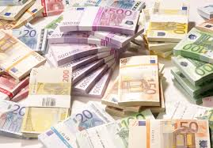
Business start-up and development
Business closure/selling
Business development
Business growth management
Business startup
Supporting infrastructure
drive
Funding sources

Slide 4
Business start-up and development
Stage I: Existence
In this stage the main problems of the business are obtaining customers and delivering the product or service contracted for. Among the key questions are the following:
Can we get enough customers, deliver our products, and provide services well enough to become a viable business?
Can we expand from that one key customer or pilot production process to a much broader sales base?
Do we have enough money to cover the considerable cash demands of this start-up phase?
The organization is a simple one—the owner does everything and directly supervises subordinates, who should be of at least average competence. Systems and formal planning are minimal to nonexistent. The company’s strategy is simply to remain alive. The owner is the business, performs all the important tasks, and is the major supplier of energy, direction, and, with relatives and friends, capital.

Slide 5
Business start-up and development
Stage II: Survival
In reaching this stage, the business has demonstrated that it is a workable business entity. It has enough customers and satisfies them sufficiently with its products or services to keep them. The key problem thus shifts from mere existence to the relationship between revenues and expenses. The main issues are as follows:
In the short run, can we generate enough cash to break even and to cover the repair or replacement of our capital assets as they wear out?
Can we, at a minimum, generate enough cash flow to stay in business and to finance growth to a size that is sufficiently large, given our industry and market niche, to earn an economic return on our assets and labor?
The organization is still simple. The company may have a limited number of employees supervised by a sales manager or a general foreman. Neither of them makes major decisions independently but instead carries out the rather well-defined orders of the owner.
Systems development is minimal. Formal planning is, at best, cash forecasting. The major goal is still survival, and the owner is still synonymous with the business.

Slide 6
Business start-up and development
Stage III: Success
The decision facing owners at this stage is whether to exploit the company’s accomplishments and expand or keep the company stable and profitable, providing a base for alternative owner activities. Thus, a key issue is whether to use the company as a platform for growth or as a means of support for the owners as they completely or partially disengage from the company. Organizationally, the company has grown large enough to, in many cases, require functional managers to take over certain duties performed by the owner. The managers should be competent but need not be of the highest caliber, since their upward potential is limited by the corporate goals. Cash is plentiful and the main concern is to avoid a cash drain in prosperous periods to the detriment of the company’s ability to withstand the inevitable rough times.

Slide 7
Business start-up and development
Stage IV: Take-Off
In this stage the key problems are how to grow rapidly and how to finance that growth. The most important questions, then, are in the following areas:
Delegation- Can the owner delegate responsibility to others to improve the managerial effectiveness of a fast-growing and increasingly complex enterprise? Further, will the action be true delegation with controls on performance and a willingness to see mistakes made, or will it be abdication, as is so often the case?
Cash- Will there be enough to satisfy the great demands growth brings (often requiring a willingness on the owner’s part to tolerate a high debt-equity ratio) and a cash flow that is not eroded by inadequate expense controls or ill-advised investments brought about by owner impatience?
The organization is decentralized and, at least in part, divisionalized—usually in either sales or production. The key managers must be very competent to handle a growing and complex business environment. The systems, strained by growth, are becoming more refined and extensive. Both operational and strategic planning are being done and involve specific managers. The owner and the business have become reasonably separate, yet the company is still dominated by both the owner’s presence and stock control.

Slide 8
Business start-up and development
Stage V: Resource Maturity
The greatest concerns of a company entering this stage are, first, to consolidate and control the financial gains brought on by rapid growth and, second, to retain the advantages of small size, including flexibility of response and the entrepreneurial spirit. The corporation must expand the management force fast enough to eliminate the inefficiencies that growth can produce and professionalize the company by use of such tools as budgets, strategic planning, management by objectives, and standard cost systems—and do this without stifling its entrepreneurial qualities.
A company in Stage V has the staff and financial resources to engage in detailed operational and strategic planning. The management is decentralized, adequately staffed, and experienced. And systems are extensive and well-developed. The owner and the business are quite separate, both financially and operationally.
The company has now arrived. It has the advantages of size, financial resources, and managerial talent. If it can preserve its entrepreneurial spirit, it will be a formidable force in the market. If not, it may enter a sixth stage of sorts: ossification.

Slide 9
Funding sources classification
Public
Grants
Equity
Private
Angel investors
Debt
Venture capital
Accelerators
Own
ICO
Crowdfunding
EU
State
Loans
Guarantees
Notes:
In addition to banking institutions, entrepreneurs in the European Union have access to other financing mechanisms, whether private or public. These options can be an alternative option to traditional bank financing.

Slide 10
Group discussion
Have you ever used non-banking funding source? Which one?
Discuss it with colleagues in a group. Share your experiences.

Slide 11
Which funding (by revenues)?
Notes:
Source: http://aviary.vc/the-big-gap/

Slide 12
Which funding (by revenues)?
Venture capital- Venture capital funds are looking to invest in companies that can be resold for hundreds of millions of euros within a few years. They are looking for extremely high rewards but are also willing to take high risks. Only a very small fraction of startups qualify for this kind of reward, and one of the biggest mistakes in the funding process for startups is to spend your time chasing venture capital funds when you clearly don’t have an interesting proposal for them.
Startup accelerators - Startup accelerators are looking for startups that can become very big, and are essentially looking for the same types of deals as venture capital funds.
Business angels- Most business angels are also looking for something that can become ‘big’, but they’re not as extreme as venture capitalist funds in their requirements for return, so you don’t have to approach them with something that could be worth hundreds of millions. Even if your startup isn’t the next big thing, business angels might be interested anyway. One of the biggest mistakes founders make when approaching business angels is to believe business angels are only driven by financial return. Money is only one reason why business angels invest in startups.

Slide 13
Which funding (by revenues)?
Banks- Unlike other funding sources, banks don’t provide equity but instead they lend money to companies in return for interest. They don’t therefore gain anything amazing if your company suddenly becomes massively successful. With only a very low reward potential (interest rate), they are only willing to take very low risks. Many startups make the mistake of chasing bank loans when their startup clearly has way too much risk to be interesting to banks.
Crowdfunding- Crowdfunding attracts different investors depending on the crowdfunding model. With reward-based crowdfunding, individuals take a risk on unproven products because they feel some kind of affinity with the company; in exchange, they receive a discount or another non-financial reward. Equity crowdfunding attracts slightly higher investments in exchange for equity, with the risk of failure offset by potentially having shares in ‘next big thing’. Crowdlending is a safer investment, where investors receive interest but play no part in
the upside when a startup succeeds.
Friends/family- Friends and family don’t really invest in your business – they invest in you. This also means they invest all over the place – even in projects that don’t make sense from a financial point of view.
Public support- Many startup projects generate value for society, and governments all over the world want to provide financial support to startups in their various forms. A common mistake made by startups is to overlook this very important source of funding.

Slide 14
Which funding? When?

Slide 15
Which funding? When?
Crowdfunding- Reward crowdfunders normally invest quickly and for personal reasons, which means they’ll invest earlier than most professional investors. But they need something to get excited about, so at least a semi-functional prototype is usually required. Equity crowdfunding normally attracts higher investments in the hope of a large financial reward, so success is more likely after the first professional funding rounds, while crowdlending is later again. Crowdlending platforms normally won’t even accept a campaign unless the company has a stable cashflow.
Banks- Startup founders should forget about banks in the initial phases. The risk is simply too high for banks to be interested until the company is early-stage positive. But some public support programmes exist that can de-risk the projects in a bank’s mindset and thereby make a bank loan more accessible earlier in the process.

Slide 16
Which funding? When?
Venture capital- Venture capital funds are willing to take very high risks in their pursuit of very high financial rewards. Many startup founders believe that a willingness to take risks means venture capital funds invest mainly when the startup is at the idea stage. Nothing could be further from the truth. A venture capital fund normally invests when there are signs of commercial traction, meaning the company has launched its first product and generates a lot of users and/or revenue.
Business angels- Business angels invest earlier than venture capital funds. But even business angels ideally want some traction before they invest. This doesn’t need to be real revenue, but ideally means the company has already gathered a talented team which has built the first beta product.

Slide 17
Which funding? When?
Startup accelerators. These are willing to go in early because they see their role as accelerating startups to a point where they can get further financing – typically from business angels or venture capital funds. But even accelerators want more than a business idea. As a minimum they want to invest in a talented team which already has built a prototype of the intended product.
Public support programmes. There are public support programmes even from the very early phases, but the majority of those work only on a co-financing basis. This means that the government only pays part of the costs and the startup needs to find supplementary funding from other sources.
Friends and family. All professional investors want some traction before they’ll be interested in investing. So which initial investors will provide you with money before the professionalsstep in? In many cases, your friends and family!

Slide 18
Group discussion
In which phase is your company at the moment? Which funding sources are available in this phase?
Discuss it with colleagues in a group. Share your experiences.

Slide 19
Personal and “love” money
Personal €:
proves you have long-term commitment
Family (‘love money’):
rarely have much capital
want to have equity?
danger: mixing business and family relations
This Photo by Unknown Author is licensed under CC BY-NC-SA
Notes:
https://www.bdc.ca/en/articles-tools/start-buy-business/start-business/pages/start-up-financing-sources.aspx

Slide 20
Private Equity
Definition:
shares representing ownership of or an interest in an entity – that is not publicly listed or traded
Ownership
significant level of influence over the firm's operations
Investor‘s motivation:
pursuit of achieving a positive return on investment (4-7 yrs)
This Photo by Unknown Author is licensed under CC BY-NC-ND

Slide 21
Private equity - examples
Skyscanner
leading global travel search business
770 staff in 10 global offices, 120% revenue growth in 8 yrs
More >>
AVG technologies
anti-virus software
7.5x increase in the number of active users,
sales of over US$400m in 2013, 11.5x increase in company’s value to US$1bn
More >>
Notes:
https://www.investeurope.eu/about-private-equity/private-equity-in-action/case-studies/#i

Slide 22
Business angels
"Angel investors are not in the corporate world nor are they part of Government when they invest in startups. They are people investing in people." Candace Johnson
Notes:
https://www.bdc.ca/en/articles-tools/start-buy-business/start-business/pages/start-up-financing-sources.aspx

Slide 23
Business Angels
Wealthy individuals
Early stages of the business
25-100k€
the right to supervise the company's management practices
VC = company, Business Angel = individual
This Photo by Unknown Author is licensed under CC BY-NC-ND
Notes:
https://www.bdc.ca/en/articles-tools/start-buy-business/start-business/pages/start-up-financing-sources.aspx

Slide 24
Business Angels - types
The Kindred Investor:
Close family member, investment based on trust
Professional relationship investor
Someone who worked you in the past
Specialty investor
Knows the field
Friend-of-a-friend investor
Trust based on recommendation
The expert investor
Experienced, good mentors
Notes:
https://www.linkedin.com/pulse/types-angel-investors-rajh-v-iyer

Slide 25
Business Angels - examples
Investors (examples):
Jeff Bezos (Amazon.com)
Paul Buchheit (Y Combinator)
Jeff Clavier (SoftTech)
More:
Business angels EU: http://www.businessangelseurope.com
European Business angels: http://www.eban.org/
EU angel investors: https://angel.co/europe/investors
Top 40 EU investors
Good EU practices
Notes:
https://www.forbes.com/sites/tanyaprive/2013/12/16/20-most-active-angel-investors/#2195be59566a
https://www.inc.com/john-boitnott/15-of-the-biggest-angel-investors-of-all-time.html
https://mashable.com/2011/10/26/how-angels-invest/#GvD_A6m5CgqE

Slide 26
Business angels: how to get funding?
1. Are you beyond the startup phase?
3. Prepare a good pitch
2. Search for an investor
4. Decide on the ownership
But not give up too much (< 30%)
+ financial projections
Angel.co, EBAN, …
Spend the money wisely
(It’s not yours)
Things to consider when asking for BA money
Notes:
http://www.eu-startups.com/2017/12/top-40-business-angels-that-are-rocking-europe-and-help-startups-grow/

Slide 27
Business Incubators
Focus on the high-tech sector
Local economic development incubators
Sharing of:
The premises, admin., logistics and technical resources
Incubation phase
~2 years
This Photo by Unknown Author is licensed under CC BY-NC-SA
Notes:
https://www.bdc.ca/en/articles-tools/start-buy-business/start-business/pages/start-up-financing-sources.aspx

Slide 28
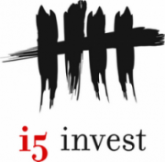
Incubators – some EU examples
Austria
I5invest, INiTS, Up to Eleven, Kubator,…
Belgium
Telenet Idealabs, NEST’Up,…
Bulgaria
3Challenge, Eleven, LAUNCHub
Croatia
Zip, …
Slovenia
ABC accelerator, Tovarna podjemov,…
Italy
H-Farm, …
See more at:
A Quick Guide To The Best European Incubators And Accelerators
enGaging project

Slide 29
How to join the business incubator?
1. Do your research
2. Consult alumni
Mentors, location, curriculum?
3. Assemble your team
Contact & discuss experiences
Team 1st, idea 2nd
4. Prepare your pitch
Doers not winners
5. Give
Equity?
Your homework before joining business incubator
Notes:
https://www.entrepreneur.com/article/235980

Slide 30
Venture Capital
For technology-driven businesses and companies with high-growth potential
IT, communications and biotechnology, 1M€+
Ownership:
give up some ownership or equity
Experience:
look for investors who bring relevant experience and knowledge to your business
This Photo by Unknown Author is licensed under CC BY-NC-ND

Slide 31
VC – Benefits, risks and examples
Source: http://businesscasestudies.co.uk/bannatyne/from-ice-cream-van-to-dragons-den-duncan-bannatyne/investors.html
Microsoft (Dave Marqurdt), Facebook, Starbucks, eBay, Intel, Apple, Google, …
Notes:
https://www.thebalance.com/what-is-a-venture-capitalist-2947071

Slide 32
VC, How to Get It?
1. Understand
2. Plan
3. Commit
Understand the product, customers and market
Prepare detailed business plan & pitch
Show commitment: invest your own finance & work hard
4. Exit
Think about exit strategy (3 yrs)
4. ROI
Show 20-25% ROI
Things to consider when asking for VC money
Notes:
https://www.entrepreneur.com/article/235980

Slide 33
EU Funds
Competition:
strong competition and the criteria for awards are often stringent
Requirements:
Detailed project description matched to the call
Criteria:
Excellence, Impact, Implementation (team)
Amount:
50k-xM€

Slide 34
EU projects, some examples
SLOVAKIA
New serums against hidden pathogens for clinical practice
ITALY
Recyclable boxes now used 110 million times a year
FINLAND
No to urban flooding
UNITED KINGDOM
Unique solution of sludge treatment demanded now around Europe and the World
DENMARK
100% of Energy needed is produced from renewable sources on island
HUNGARY
Budapest waste water almost 100% biologically treated
…
More: http://ec.europa.eu/budget/competition/27projects/vote_en.cfm

Slide 35
Group discussion
Are you familiar with EU funding opportunities? Have you ever applied for EU funds?
Discuss it with colleagues in a group. Share your experiences.

Slide 36
Before applying for public funding…
Public funding is a great source …
…of capital for many startups
Do your homework …
… and research what is relevant for you!
Three major forms of public funding relevant for startups:
Grants, Equity, Loans
Often a lot of competition …
… to get the funding
Public funding rarely support “ideas” …
… you need to bootstrap before
It takes a lot of work to be successful in your applications …
… but the payoff is worth it!
Notes:
Source: https://startupfundingbook.com/public-funding-for-startups/

Slide 37
Before applying for public funding…
Formal (often bureaucratic) …
… application process
You will have to prove that …
… you will help the Government/EU realize their goals
The goals are different from grant to grant …
… also administrated by different public bodies
You will have to co-invest …
… so prove that YOU also want to do it. They normally never fund 100% of projects/activities (exceptions: SME Inst Ph1, E+ KA2,…).
Search for EU 2020 goals and priorities!
Notes:
Source: https://startupfundingbook.com/public-funding-for-startups/

Slide 38
How to select the right EU funding programme…
1. Decide: Type of the project ?
2. Decide: Phase ?
3. Decide: location
Research, training, mobility, culture, infrastructure, cooperation?
Idea, Development, Commercialization, Dissemination? TRL!
National, cross-border, international?
4. Select:
H2020, Erasmus+, Life, Creative Europe, Structural funds,…
4. EU priorities?
Employment, R&D, Climate change, Education, Poverty

Slide 39
Crowdfunding
Definition:
Funding a project or venture by raising many small amounts of money from a large number of people
Types:
Lend, Reward-based, Equity, Debt-based, Litigation, Donation, Hybrid: software value token (ICO)
Examples:
Kickstarter, Adrifund, Indiegogo, Patreon, GoFundMe
This Photo by Unknown Author is licensed under CC BY-SA

Slide 40
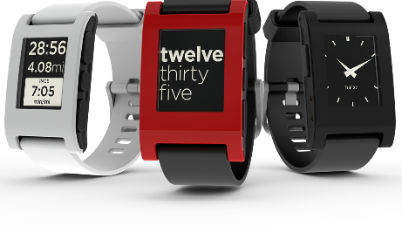
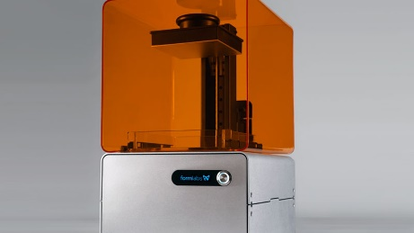
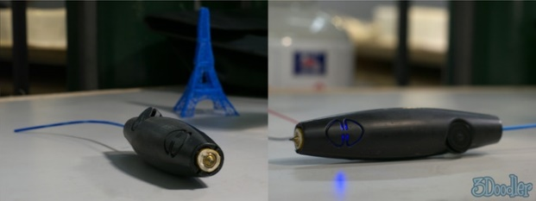
Crowdfunding - some examples
The Pebble E-Paper Watch
raised $10,266,845 in 37 days
Ouya (open-source game console)
$8.5 million in 29 days via Kickstarter
Formlabs 3D Printer
$2,945,885
Oculus Rift (VR headset)
$2,437,429 raised in 30 days
3Doodler
$2,344,134 raised in 34 days
More >>
Notes:
https://www.forbes.com/sites/wilschroter/2014/04/16/top-10-business-crowdfunding-campaigns-of-all-time/#48ce6d13e9fd

Slide 41
How to start crowdfunding campaign?
1. Pick your project
2. Select the realistic budget
3. Prepare a convincing pitch
4. Find a crowdfunding platform
Specific, clear outcome
=funding target + commissions
e.g. short attention grabbing video
5. Start campaign
6. Keep in touch
Kickstarter, Adrifund, …
Use social media to spread the word
Updates about progress
Notes:
https://knowhownonprofit.org/how-to/how-to-and-why-set-up-a-crowdfunding-campaign
https://www.entrepreneur.com/article/288277

Slide 42
ICO (Initial Coin Offering)
Definition:
Hybrid of IPO and crowdfunding
(Currently) an unregulated means by which funds are raised for a new cryptocurrency venture
Bypass the rigorous and regulated capital-raising process required by venture capitalists or banks
For whom:
Startups
Examples:
Ethereum, Viberate, Iconomi,
Beware:
Early development, high risk
Some are fraudulent
Notes:
https://www.investopedia.com/terms/i/initial-coin-offering-ico.asp
An unregulated means by which funds are raised for a new cryptocurrency venture. An Initial Coin Offering (ICO) is used by startups to bypass the rigorous and regulated capital-raising process required by venture capitalists or banks. In an ICO campaign, a percentage of the cryptocurrency is sold to early backers of the project in exchange for legal tender or other cryptocurrencies, but usually for Bitcoin.
Also called an Initial Public Coin Offering (IPCO).
Read more: Initial Coin Offering (ICO) Definition | Investopedia https://www.investopedia.com/terms/i/initial-coin-offering-ico.asp#ixzz55qiM5Nhw

Slide 43
ICO
ICO is a digital stock certificate
crowdfunded cryptocurrency is pre-allocated to investors in the form of "tokens," in exchange for:
legal tender or
cryptocurrencies (Bitcoin, Ethereum)
ICO may sell a right of ownership OR royalties to PROJECT
“utility token” can be exchanged for a unit of service
Comparison with IPO:
IPO sells shares in the ownership of a COMPANY
2017:
More than 400 ICOs
10% are scams
Notes:
https://en.wikipedia.org/wiki/Initial_coin_offering

Slide 44
Should you consider an ICO to fund your innovation?
Properties:
Tokens can be exchanged for service
Tokens can be traded (as stocks)
The value of the token is determined by supply and demand
Pro:
Cheaper (than IPO), less hassle
Exposure to new investors
Quick cash in-out for investors
Con:
Network congestion (BTC limitations)
Value corrections
Risky (for investors)
Regulatory issues
2. Company issues tokens
3. Investors buy tokens (using BTC or ETH)
4. Investors exchange tokens for services or sell them
1. Project idea + whitepaper
Notes:
https://www.verypossible.com/blog/should-you-consider-an-initial-coin-offering-to-fund-innovation

Slide 45
How much does ICO cost?
2017: 235 ICO offerings, $4B in funding
Planning ICO (marketing strategy)
Project readiness assessment: 5000$
ICO project manager per month: 18.000$
Whitepaper (50 hrs): 10.000$
ICO landing page: 10.000$
Localization per language: 2.000$
ICO smart contract (ERC-20 token issuing): 5.000$
PR, marketing: 150.000$
Notes:
Source: https://medium.com/@adrianbarwicki/hack-your-ico-marketing-strategy-750a10032fb3

Slide 46
So, should you use ICO?
Separate hype from reality
Easier than traditional funding sources, but not easy
Understand legal, compliance and security challenges
Involve law and IT security experts
Educate your team
From C-suite down
Notes:
https://www.verypossible.com/blog/should-you-consider-an-initial-coin-offering-to-fund-innovation
https://medium.com/@mccannatron/guide-to-launching-an-initial-coin-offering-ico-94587af2c8d5

Slide 47
Summary: Benefits of blockchain and cryptocurrencies for entrepreneurs
ICO & Blockchain technologies
Develop an idea and get funding through ICO
Cryptocurrencies
C2B international payments (some educational institutions accept BTC)
B2B international payments (future)
Investments and wealth storage

Slide 48
Some EU sources of Funding
ICT:
CIP
Creative Europe
EaSI
EIB
InnovFin
Structural Fuds
EFSI
EIF
LIFE
Progress Microfinance
Startups
← +:
COSME
WB EDIF

Slide 49
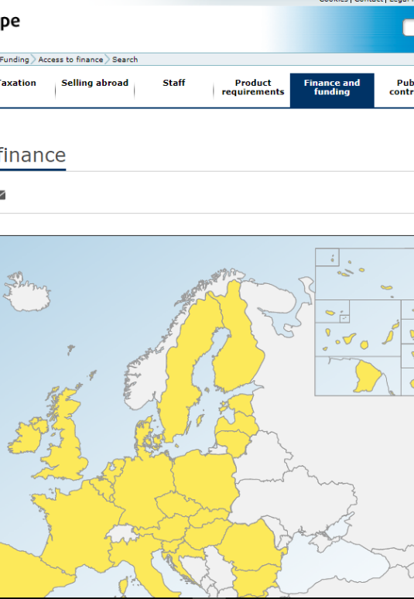
Access to finance
EU funding possibilities:
Access to finance
EU funding programmes (direct and indirect funding)
Most interesting calls for entrepreneurs:
H2020 SME Instrument Phase 1 (50k€), 2(2,5M€), 3(support)
Erasmus+ Key Action 2
Others (non-EU):
Norway grants

