Slide 1
Content Marketing
Content is king

Slide 2
… but
Source and more great quotes: http://www.slideshare.net/NewsCred/quotes-about-content-marketing

Slide 3
Outline
What is content marketing?
What’s the purpose of content marketing?
Usual ways of content publishing
What are you going to blog about?
Hacks
Some useful Tools

Slide 4
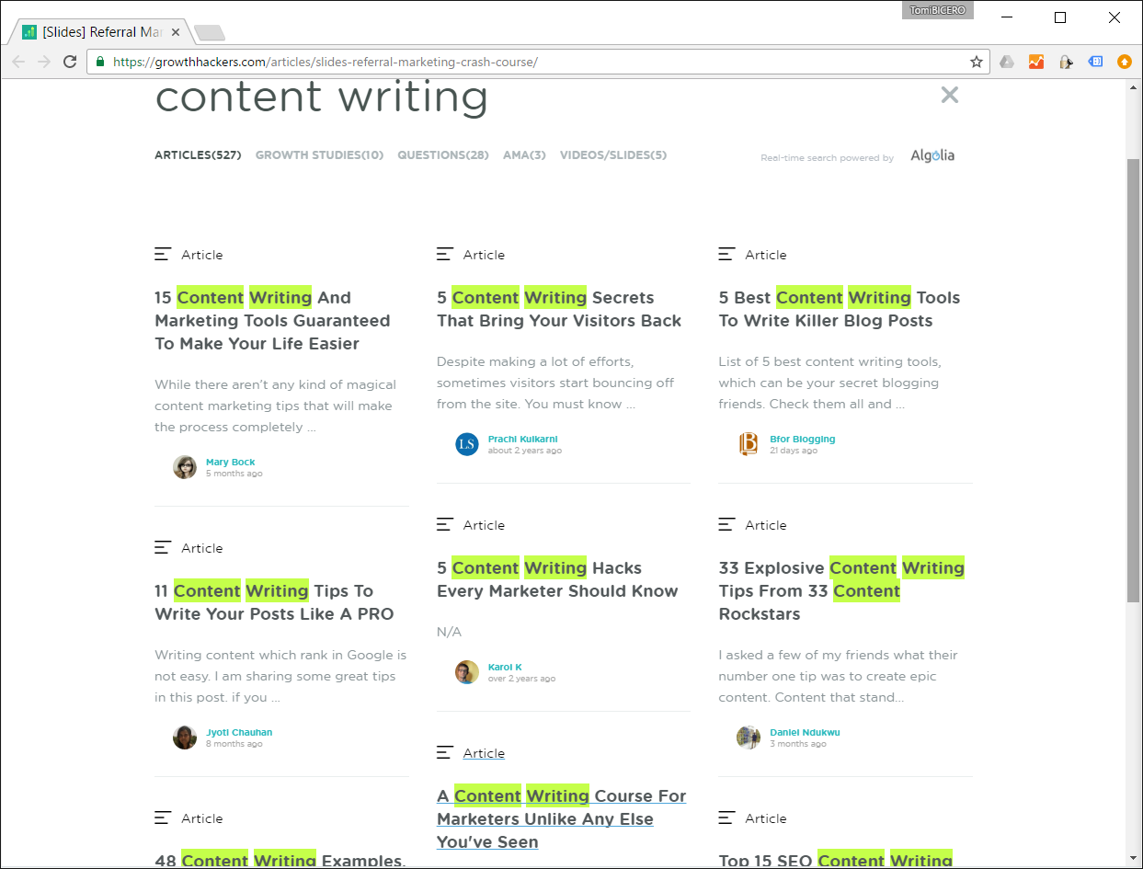
What is content marketing?
Content marketing is a strategic marketing approach focused on creating and distributing valuable, relevant, and consistent content to attract and retain a clearly-defined audience — and, ultimately, to drive profitable customer action.
Source: http://contentmarketinginstitute.com/what-is-content-marketing/

Slide 5
What’s the purpose of content writing?
The purpose of content writing is:
to establish yourself as a trustful company / person with the expertise in your field,
to educate (or entertain) potential customers.
Write great content
More readers
More customers
More trust

Slide 6
Content marketing is not new
https://youtu.be/9OHgMMpGLzk

Slide 7
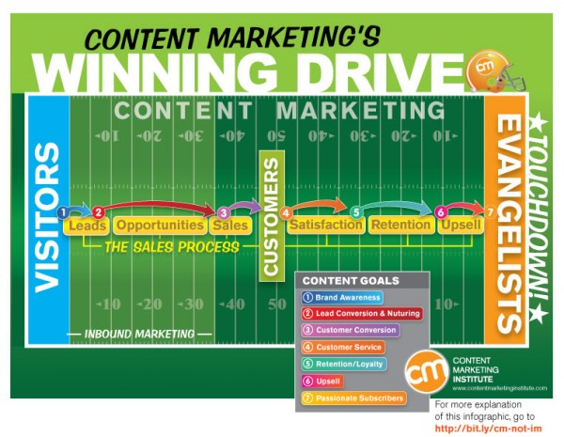
Great content converts visitors to evangelists…
… if you have a great product / service, of course.
Source: http://contentmarketinginstitute.com/what-is-content-marketing/

Slide 8
Quality content is the core of the marketing
Social media marketing: Content marketing strategy comes before your social media strategy.
SEO: Search engines reward businesses that publish quality, consistent content.
PR: Successful PR strategies address issues readers care about, not their business.
PPC: For PPC* to work, you need great content behind it.
Inbound marketing : Content is key to driving inbound traffic and leads.
Content strategy : Content strategy is part of most content marketing strategies.
* Pay per click
Source: http://contentmarketinginstitute.com/what-is-content-marketing/

Slide 9
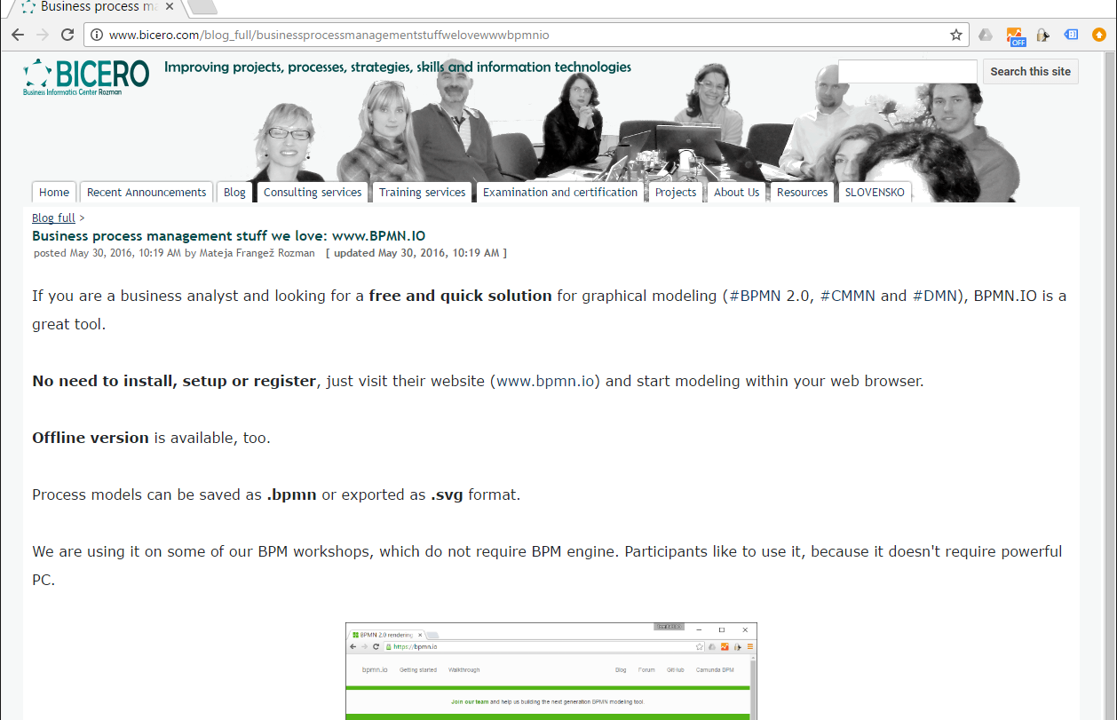
Usual way of content publishing
Publish it on your primary content management system (webpage / blog / youtube / LinkedIn articles… ).
Share it through social media networks.

Slide 10
Blogging/website platforms
Source& more: http://makeawebsitehub.com/choose-right-blogging-platform/

Slide 11
Web page
You can focus on content right from the start.
The quickstart: Wordpress, Wix, Google Sites, … there are plenty of platforms for quick and HTML-free start of your website.
A quick hack: Register your own domain and associate with your site above. It will look more professional:
mysite.wordpress.com → mysite.com
Old school: Your own custom built HTML website on a dedicated web server.
Most advanced: Your own custom developed dynamic web application.

Slide 12
LinkedIn articles
Pros:
Appropriate for business related short articles
Tightly integrated into your LinkedIn profile
Analytics
B2B community
Cons:
Limited editing capability
Platform lock-in

Slide 13
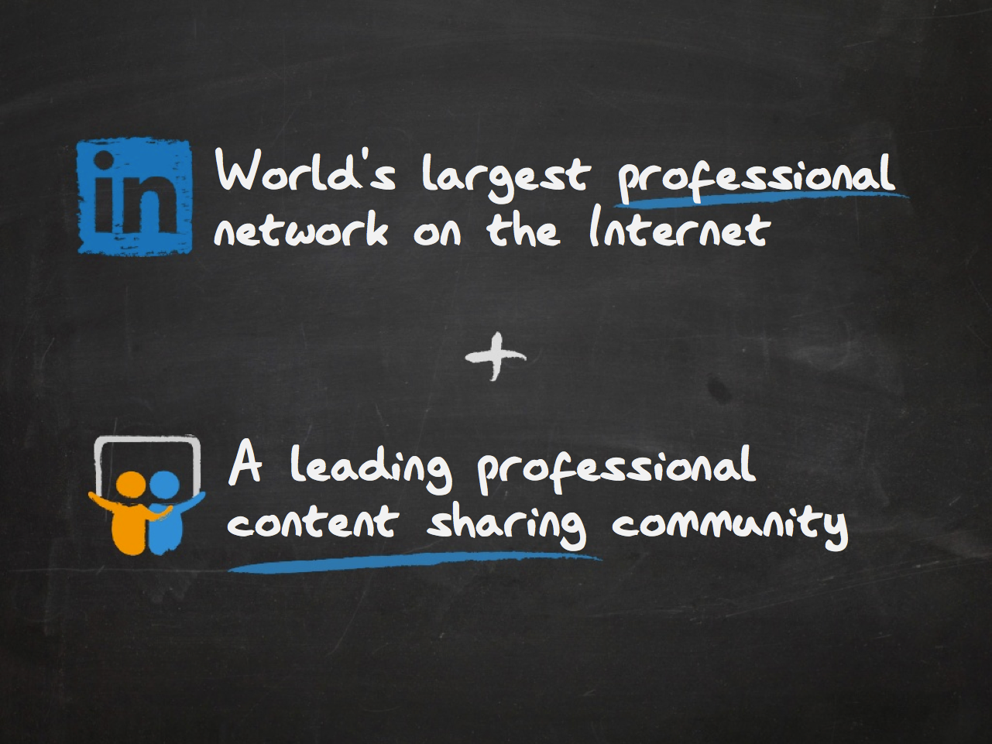
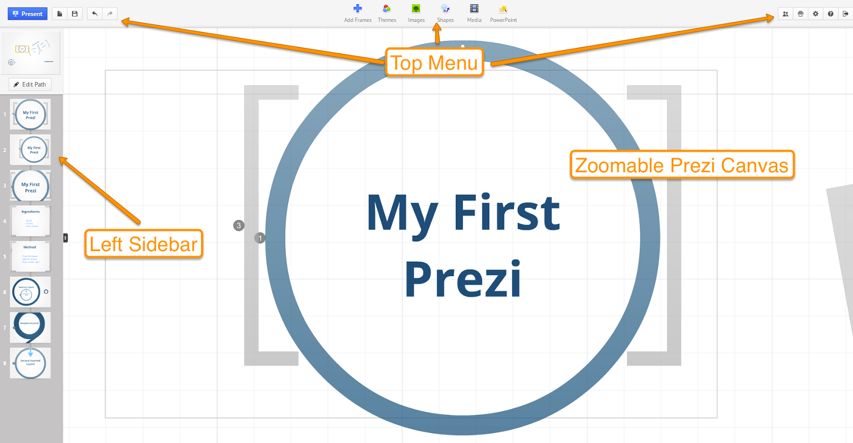
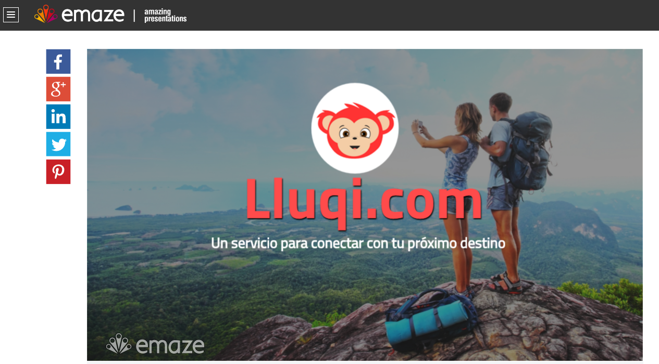
Platforms for presentation publishing
Prezi
SlideShare
Emaze
Google Presentations

Slide 14
Infographics
Infographics is a great way to show summarized, easy digestible content.
← See full growth hacking infographics here:
https://www.entrepreneur.com/article/277157

Slide 15
Video
Video is a great & effective channel, but also the costliest and can not update them.
It’s perfect for telling stories.
It’s easily shared.
People will consume more and more video content.
It can convince people to buy something.
See the video. Would you buy it?
Video source: https://www.facebook.com/bernhard.manufaktura/videos/1059799364037825/?video_source=pages_finch_trailer
Source: https://retargeting.biz/blog/the-future-is-video-content

Slide 16
What are you going to blog about?
Listicles
How-tos
Politics
Bacon
Recipes
Beginner guides
Ultimate guides
Frequently asked questions
Interviews
Personal stories
Charity and activism
People features
Product reviews
This is a listicle (short article with list of items)
Source:N. Patel, https://www.quicksprout.com/2016/08/31/top-35-blogging-ideas-that-are-guaranteed-to-be-popular/

Slide 17
What are you going to blog about?
Sourced news
Gifs and memes
Myth-debunking
Virtual reality
Internet of things
Automation
Troubleshooting guides
Contests
Advice
Productivity tips
Travel
History
Funny stories
Parenting tips
Source:N. Patel, https://www.quicksprout.com/2016/08/31/top-35-blogging-ideas-that-are-guaranteed-to-be-popular/

Slide 18
What are you going to blog about?
Upcoming events
Internet stars
Tech support
Gift ideas
Best-ofs
Respond to readers
Short assignment:
Select the type of your next blog post from this list!
Source:N. Patel, https://www.quicksprout.com/2016/08/31/top-35-blogging-ideas-that-are-guaranteed-to-be-popular/

Slide 19
Once upon a time...
Hack #1 of content writing: Master the art of great first sentences
Hack #2 of content writing: Teach yourself how to write short stories
You have to earn it, learn it, and practice it.

Slide 20
Hack #1: Great first sentences
Raising interest/curiosity: “When Hugh was in the fifth grade, his class took a field trip to an Ethiopian slaughterhouse.”
A question: “If I could show you a way to slash your health insurance costs by 40% -- and still get top-quality care…would you be interested?”
Direct: “Here's what the experts say: ……. ”
A rapport: “If you're like I am, before you make a big decision you make sure you have all the facts ……. ”
Source: http://www.businessknowhow.com/directmail/salesletters/leadin.htm
http://www.mobiloitte.com/blog/content-writing-course/?utm_campaign=Submission&utm_medium=Community&utm_source=GrowthHackers.com

Slide 21
Hack #1: Great first sentences
48 more great openers: http://www.targetmarketingmag.com/article/48-idea-starters-direct-mail-letter-email-openers/all/

Slide 22
Hack #2: Teach yourself how to write short stories
How do you start?
Hack #3: All you have to do is write one true sen­tence (paragraph). Write the truest sen­tence you know.
“Maybe you built a successful business that was taken down by someone else’s stupid mistake. Maybe you bent over backwards to hold your marriage or dating relationship together, and it still fell apart.”
Source: http://www.mobiloitte.com/blog/content-writing-course/?utm_campaign=Submission&utm_medium=Community&utm_source=GrowthHackers.com

Slide 23
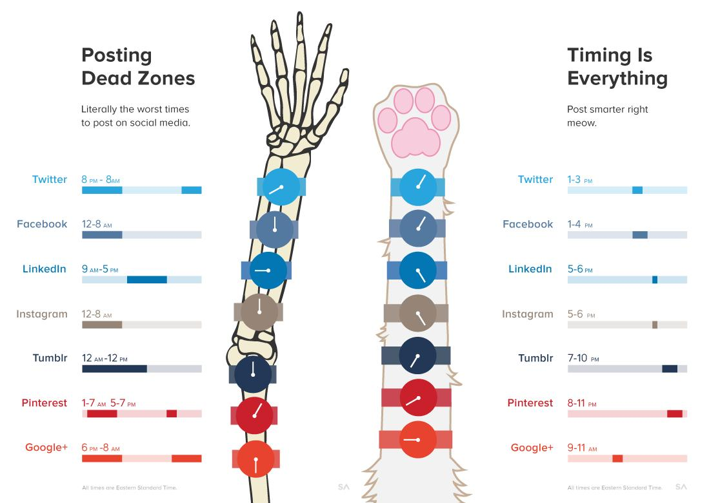
Timing is everything (besides the content)

Slide 24
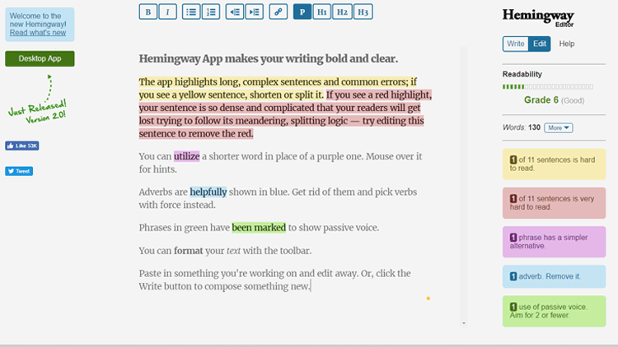
Tools for better writing
#1. Hemingway Editor
(for more readable texts)
#2. Google Docs (especially for team editing)
Source: https://www.bforblogging.com/content-writing-tools-to-write-a-blog-post

Slide 25
Tools for better writing
#3. Grammarly
(Yes, there is a better spell checker as MsOffice’s out there)
Source: https://www.bforblogging.com/content-writing-tools-to-write-a-blog-post

Slide 26
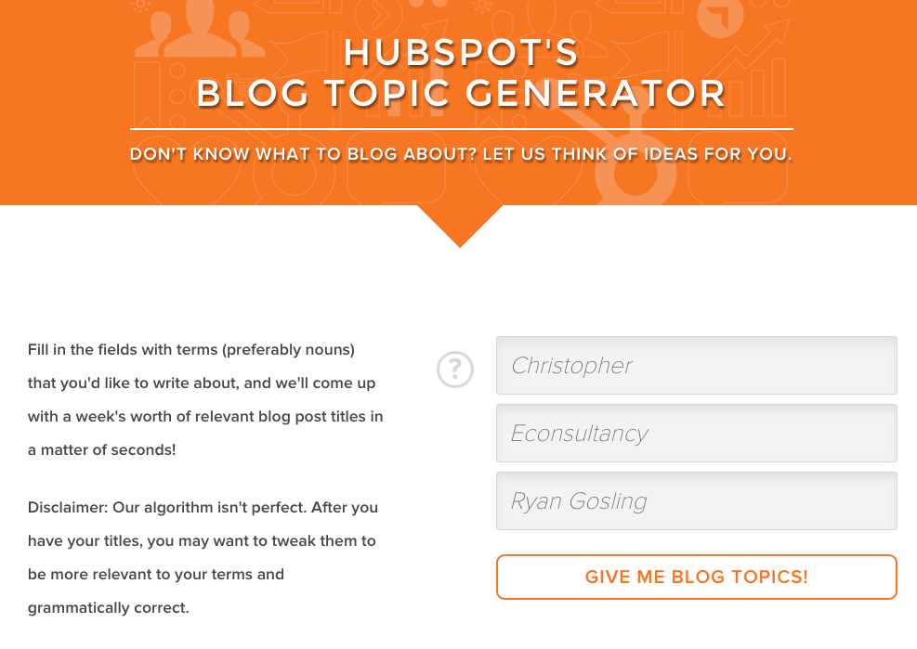
Tools for better writing
17 more tools for idea generation:
https://econsultancy.com/blog/66187-17-fantastically-useful-tools-for-content-writers-and-bloggers/
Hidden assignment: Go and try some of them. Right now.
Source: https://econsultancy.com/blog/66187-17-fantastically-useful-tools-for-content-writers-and-bloggers/

Slide 27
A very serious final question
Do you think all your FB followers/likes/shares are real persons?
Do you think all of your Google AD clicks are from real persons?

