Slide 1
IDEATION PHASE: IDEATION METHODS & DESIGN THINKING; FIRST STEPS TO DEVELOP YOUR IDEA

Slide 2
Outline
Design Thinking
The Six Steps
Ideation
Prototype
Implement
Evaluate
Business Model Canvas

Slide 3
THE DESIGN THINKING APPROACH
Design Thinking is an approach to resolve issues outside of professional design practice, such as in business and social contexts
Design thinking in business uses the designer's sensibility and methods to match people's needs with what is technologically feasible and what a viable business strategy can convert into customer value and market opportunity
Design Thinking should not be seen as a concrete and inflexible approach to design; the component stages identified in the image above serve as a guide to the activities that you would typically find

Slide 4
THE SIX STEPS
Design Thinking should not be seen as a concrete and inflexible approach to design; the component stages identified in the image above serve as a guide to the activities that you would typically find
This creates a perpetual loop, in which the designers continue to gain new insights, develop new ways of viewing the product and its possible uses, and develop a greater understanding of the users and the problems they face
The first step of design thinking is “Discover the problem or needs”, that means problem detecting and discovering what is the problem which you are trying to solve

Slide 5
Ideation
During the third stage of the Design Thinking process, designers are ready to start generating ideas
You’ve grown to understand your users and their needs in the first stage, and you’ve analysed and synthesised your observations in the Define stage, and ended up with a human-centered problem statement
With this solid background yourself and your team members can start to 'think outside the box' to identify new solutions to the problem statement you’ve created, and you can start to look for alternative ways of viewing the problem
There are hundreds of Ideation techniques such as Brainstorm, Brainwrite, Subtracting method, Morphological Analysis and Forced relationship

Slide 6
Ideation
Brainstorm and Subtracting method sessions are typically used to stimulate free thinking and to expand the problem space
It is important to get as many ideas or problem solutions as possible at the beginning of the Ideation phase
It is fundamental to assure that all participants share a deep background knowledge on the topic of the brainwriting session
This is a worksheet that has to be handed out to each participant and consists of a grid where the heading of the columns are Idea 1, Idea 2 and Idea 3 and the rows identify the name of who has contributed to that particular suggestion

Slide 7
Prototype
The design team will now produce a number of inexpensive, scaled down versions of the product or specific features found within the product, so they can investigate the problem solutions generated in the previous stage
This is an experimental phase, and the aim is to identify the best possible solution for each of the problems identified during the first three stages
The solutions are implemented within the prototypes and, one-by-one, they are investigated and either accepted, improved and reexamined, or rejected on the basis of the users’ experiences

Slide 8
Implement
Designers or evaluators rigorously test the complete product using the best solutions identified during the prototyping phase
This is the late stage of the model, but in an iterative process, the results generated during the testing phase are often used to redefine one or more problems and inform the understanding of the users, the conditions of use, how people think, behave, and feel, and to empathise
Professional market research is complex and expensive but even a non-professional market survey will give you a information about who the target market responded

Slide 9
Evaluate
The final stage is evaluating your market research results and implicating them to your idea
A SWOT analyze is a good way to evaluate your final product
The beauty of design thinking is that after this final stage you can start again and improve your idea with the same steps

Slide 10
THE BUSINESS MODEL IDEATION TECHNIQUES

Slide 11
9 blocks:
1. Customer segments: who are your customers
2. Value proposition: Why do your customers buy from you
3. Channels: how do your products or services are delivered to the market
4. Customer relationships: how do you get, keep and grow your customers
5. Revenue streams: how does your business earn money
6. Key Resources: which key resources are requested in order to spread our value
7. Key Activities: which strategic activities does your business perform in order to deliver your value proposition
8. Key Partnership: which are our key partners. Which are our suppliers. Which activities do our key partners carry out.
9. Cost Structure: which are the major costs incurred by your business.
Left part of the Canvas corresponds to the efficiency, right part to the value

Slide 12
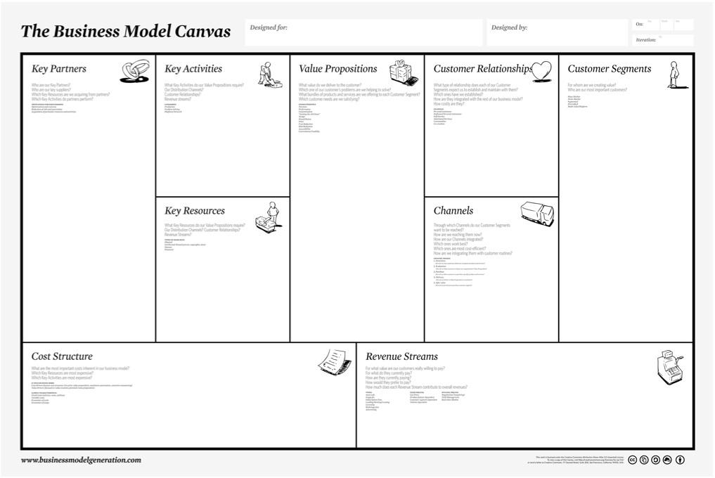

Slide 13
What is it?
It is a one-page business methodology traditionally applied in order to elaborate innovative business models.
It is a simple graphical template describing nine essential components. The individual elements prompt consideration of a business’ full scope, while the layout encourages thought about how the pieces fit together.
Each of these blocks needs to be accurately filled in, and revised regularly to ensure the business model is still accurate.

Slide 14
A useful trick
Think of the the Business Model Canvas as divided into two large areas:
the right half represents the part of your business facing the customer
the left half holds everything you need to have or do in order to provide the right half
Think about a theater stage: the right half is the front stage facing the audience, the left side is the back stage where the magic is created.

Slide 16
You should avoid the temptation of starting to fill in the canvas from left to right. Rather start with the most important areas for your business model. For most businesses these most important areas are the Value Proposition and the Customer Segments. So you almost always start with the front stage and your customer.
Starting with the customer segment you think about questions like: Who is the audience you want to serve? Who’s problems you want to solve? If you can, don’t start with a product idea here and try to work backwards; rather pick an audience you like and start to learn about their wishes and problems. Even better: pick an audience you already know and understand, then dig deeper into their wishes and problems
Don’t fall into the trap of writing something like “mass market” or “women age 17–56” here. Narrow your audience down as much as you can. Remember even Facebook started with a very niche audience of students of only one university! The smaller you can make your initial customer segments, the easier it will be to sell to them. Once money rolls in, you can always expand to a mass market later on.
Most business models have more than one customer segment. Not all of these segments need to be paying customers: users of Google Mail are a non-paying customer segment, while advertisers bring in the revenue through Google AdWords. Sometimes you even need to list customer segments further away, like stakeholders in local communities, to create a coherent business model. But don’t scratch your head too long in the beginning — you can always come back and refine things later.

Slide 17
Most business models have more than one customer segment. Not all of these segments need to be paying customers: users of Google Mail are a non-paying customer segment, while advertisers bring in the revenue through Google AdWords. Sometimes you even need to list customer segments further away, like stakeholders in local communities, to create a coherent business model. But don’t scratch your head too long in the beginning — you can always come back and refine things later.
Next you move to the value proposition. You already have a thorough understanding of who your customers are and what problems or wishes they have. Now it’s time to come up with ideas that could solve one or more of their problems and help your customers get their jobs done. Don’t think about features! Start from the problem, then find things (services or products) that would benefit the customer and solve or alleviate their problem. List these benefits here. Later when designing your product you will derive features that will result in these benefits for the customer.
For the rest of the front stage ask yourself:
How will the value proposition reach my customer? ➜ Channels
How will I create and retain customers? ➜ Customer Relationships
Who will pay and how will I earn revenue? ➜ Revenue Streams
This concludes the front stage. Move on to the back stage now.

Slide 18
Think about which resources you need to fulfill your customers’ needs. Do you need physical goods, licenses or financial assets? Write that down in key resources. Don’t list everything here, just the essential stuff that is key to your business. In addition you need to perform some key activities to create and deliver your product. This could be developing a critical algorithm, researching new materials or providing one-on-one customer care. Again, just list the essentials.
On the far left, you can list key partners. Not every business has or needs key partners. But it’s worth to think about whether partnering with other companies could help you get your business off the ground — you don’t need to do everything yourself. A key partner could provide you with a channel to reach an existing customer base, create the software you need or help you persuade important interest groups.
Now look at the left side of your canvas and try to figure out, where the main costs lie. What will you have to pay for in order to deliver your value proposition to your customers? List that in the cost structure area. You might also want to add rough estimates of each cost to calculate the value of your business in a later step.

Slide 19
Customer Insights
Customer insight is the first step towards the mutually beneficial one-to-one customer relationships that every marketer strives to create

Slide 20
WHERE PRODUCT DEVELOPMENT SHOULD START
Most successful organizations have a strong focus on customer research but fail to incorporate their customers’ perspective in the product design and even the business model design stage of the business
It can lead to discoveries and insights which could help the company gain an edge in the competitive market for customer mindshare
Major companies invest a significant sum on attaining insight into the social and psychological makeup of their customers through employing teams of anthropologists and sociologists
The approach asks for a shift from an organization specific perspective to a customer-centric approach

Slide 21
WHERE PRODUCT DEVELOPMENT SHOULD START
Companies have traditionally myopically considered what it wants to sell the customers, how they can be reached with the minimal expenditure of resources, the nature of relationship the company wants to form with the customer, and how it will earn money from its targeted customer segment

Slide 22
Do you know your customers?
When an entrepreneur is asked who his customer is, it is easy to get lost in targeting everyone that their product or service would appeal to
Direct and indirect consumers are invariably linked to the business because the entrepreneur is trying to think big
Starting the discussion from there, the entrepreneur must then evaluate what kind of pains this segment has, who these people are and why they would buy from your business over other solutions available in the market

Slide 23
How to discover your prospects world view
What should I do next?
What is truth and what is false?
What actions should I take to reach my goals
How can we make others understand our intentions?

Slide 24
Difference between worldview and personas
Entrepreneurs often mistake a world view with a persona because both concepts seem to overlap
However, persona refers to a group of people who have similar consumer behavior patterns i.e. regardless of their demographics they share buying patterns, their usage of customer services are similar, and they have similar behaviors, motivations, and attitudes
A world view on the other hand highlights why a consumer has these behaviors, attitudes and motivations as well as the reason behind their buying behavior

Slide 25
The Empathy Map
The intellectual identification with the feelings, thoughts or attitudes of another
The vicarious experiencing those feelings, thoughts or attitudes

Slide 26
Empathy map basics
What thoughts does this customer normally have and how does he usually feel?
What or who does the customer normally listen to?
What does the customer see?
What does this customer say and do?
What is this supporter’s pain?
What is his gain?

Slide 27
Prototyping
Collect feedback from users/ stakeholders about the functionality of the product before the public release
Reveal areas for improvement and help identify faults and usability issues before the public release
Improve team efficiency and collaboration
Allow the user to interact with a working model of their product
Help convert an abstract idea into a tangible product in a cost-effective way
Identify if your product idea is a weak one and cost you heavily before actually moving forward with it

Slide 28
Prototyping Process
Prototyping is the 4th step of the design thinking process
Before you determine how you should go about the prototyping process, you have to have identified the users, defined their problem, and brainstormed and selected a proper solution in the form of a product or service
You prototype won’t be able to represent all the product features, therefore you might want to select the key features that will help you gather as much feedback from the user as possible

Slide 29
Types of Prototyping
Prototyping methods are generally divided into two separate categories: low- and high-fidelity prototyping

Slide 30
Low-Fidelity Prototyping
Storyboarding
Sketching
Card sorting
'Wizard of Oz'
Quick and inexpensive
Possible to make instant changes and test new iterations
Disposable/throw-away
Enables the designer to gain an overall view of the product using minimal time and effort, as opposed to focusing on the finer details over the course of slow, incremental changes
Available to all; regardless of ability and experience, we are able to produce rudimentary versions of products in order to test users or canvas the opinions of stakeholders
Encourages and fosters design thinking

Slide 31
Low-Fidelity Prototyping
An inherent lack of realism
Depending on your product, the production of low-fi prototypes may not be appropriate for your intended users
Such prototypes often remove control from the user, as they generally have to interact in basic ways or simply inform an evaluator, demonstrate or write a blow-by-blow account of how they would use the finished product
Engaging: the stakeholders can instantly see their vision realised and will be able to judge how well it meets their expectations, wants and needs
User testing involving high-fi prototypes will allow the evaluators to gather information with a high level of validity and applicability
They generally take much longer to produce than low-fi prototypes

Slide 32
Low-Fidelity Prototyping
When testing prototypes, test users are more inclined to focus and comment on superficial characteristics, as opposed to the content
After devoting hours and hours of time producing an accurate model of how a product will appear and behave, designers are often loathed to make changes
Software prototypes may give test users a false impression of how good the finished article may be
Making changes to prototypes can take a long time, thus delaying the entire project in the process

Slide 33
Guidelines for Prototyping
Just start building
Don’t spend too much time
Remember what you’re testing for
Build with the user in mind

Slide 34
Storytelling
Your brand is the mentor in the story but the true hero of the journey is your customer
The more you and your brand understand and empathize with your customers’ stories, and how you can mentor them in their quest for a better life, the more abundant growth you will experience in all aspects of your business, and in your life
As you explore the 10-step Story Cycle below, picture how the process is already playing out in your business, in the lives of your employees, with your customers, and in your own personal journey
The backstory helps you quickly articulate your #1 position in the marketplace: what you do better than anyone else

Slide 35
Storytelling
This is your first step out of the primordial muck of commoditization creating meaning in the hearts and minds of your audiences for your brand
What does your hero want as it relates to the product or service you offer, and how does their quest intersect with the goals and aspirations you have for your brand?

Slide 36
THE BUSINESS MODEL CANVAS
The Business Model Canvas is a strategic tool used for visually developing or displaying a business model
A BMC helps determine and align the key business activities and their relationship to your value proposition

Slide 37
The 9 elements of a business model canvas
The canvas provides you with nine key business elements to illustrate, summarize, and track
The 9 blocks of a BCM are: List the key partnerships your business leverages or relies upon for success
List the key resources your business relies upon or uses in order to operate and provide services

Slide 38
Customer relationships
Define and describe the primary relationships you have with your customers, including how you interact with this, how these interactions differ among different types of customers, and the level of support the different customers receive
Instead, the BMC is used to summarize and visually illustrate the most important information of a business model, and to provide centralized ongoing clarity
The BMC is also appropriate for visualizing new business models, as it helps organize and consolidate ideas around your key functions

Slide 39
Benefits of using a business model canvas
The Business Model Canvas is extremely useful in structuring your business model visually
This helps at different stages of defining your business model
Many find it easier to visualize a business model in one simplified view

Slide 40
Focuses you on your value proposition
The value proposition is at the heart of the entire Business Model Canvas, so you can continually focus on the reason why your business exists
With the Business Model Canvas, you can see how all of the elements of your business are interrelated and inform or affect each other
Because the visual presentation is easy to grasp and understand, teams, stakeholders, advisors, and partners should find the canvas to be relatively straightforward and easy to understand

