Slide 1
Managing Bookkeeping and Accounts
Key Concepts and Best Practices for Success

Slide 2
Learning Outputs
Understanding bookkeeping and accounting
Differences between bookkeeping and accounting
Importance of bookkeeping and accounting
Different bookkeeping systems
Steps to establish a bookkeeping system
Best practices and common mistakes
Accounting methods for freelancers
Core accounting principles

Slide 3
What Are Bookkeeping and Accounting?
Bookkeeping: Involves maintaining a record of your business’s financial activities, such as income, purchases, payments, and receipts. It focuses on documenting these transactions in an organized manner.
Accounting: This is the process of analyzing, interpreting, and sharing financial data. Accounting helps in making strategic business decisions based on the data gathered from bookkeeping.

Slide 4
What is Bookkeeping?
Bookkeeping is more than just documenting numbers; it includes:
Recording Transactions: Freelancers focus on tracking income and expenditures.
Categorizing: Classifying income and expenses to understand the sources and uses of funds. For instance:
Income from sales = €2400
Expense for rent = €1500
Accurate bookkeeping provides valuable insights, helps identify issues, and supports goal setting.

Slide 5
Reconciling Your Records
Reconciliation is the process of matching recorded transactions with your bank or credit card statements, usually done at the end of each month. It helps:
Detect errors
Prevent fraud
Keep your business finances accurate
Bookkeeping also aids in setting budgets and making well-informed business decisions.

Slide 6
Bookkeeping Vs Accounting
Bookkeeping deals with recording transactions, while accounting focuses on analyzing that data. Here's how they differ:
Bookkeeping Tasks | Accounting Tasks
Recording day-to-day transactions | Adjusting revenue/expenses entries
Sending invoices and receiving payments | Interpreting financial statements
Conducting monthly reconciliations | Offering financial advice, tax planning
 | Preparing and filing tax returns

Slide 7
The Importance of Bookkeeping and Accounting
Proper bookkeeping and accounting are crucial for a thriving business. They ensure:
Accurate tracking of income and expenses
Better decision-making
Easier budgeting
Smooth and timely tax filings
Without these systems, businesses struggle to manage their finances and grow sustainably.

Slide 8
Types of Bookkeeping Systems
There are various bookkeeping methods suited to different needs:
Single-Entry System:
Simple, typically for small businesses
Only one entry per transaction (e.g., income or expense)
Lacks detailed tracking of assets, liabilities, and equity
Double-Entry System:
Records every transaction as both a debit and credit
Provides a more comprehensive financial picture
Ideal for larger or more complex businesses

Slide 9
Other Bookkeeping Options
Bookkeeping Software: Automates data entry and reporting. Available in single- and double-entry formats, these programs integrate with invoicing, payroll, and tax tools.
Virtual Bookkeeping: Outsource bookkeeping to professionals who handle it remotely, offering flexibility and expertise.
Freelancers should choose a system that aligns with their business’s size, complexity, and goals.

Slide 10
Setting Up a Bookkeeping System
A solid bookkeeping system is vital for freelancers and businesses alike:
Select an Accounting Method:
Cash-based accounting records transactions when money is exchanged.
Accrual-based accounting records income and expenses as they are incurred, even if cash hasn’t changed hands.
Set Up a General Ledger: This tracks all transactions by account (e.g., income, expenses, assets, liabilities).
Open Business Accounts: Separate your business and personal finances by using dedicated bank accounts for business transactions.

Slide 11
Recording Transactions
Ensure every business-related financial transaction is recorded, supported by receipts, invoices, or bills. Consider using accounting software to simplify this process.
At the end of the accounting period (monthly or quarterly), reconcile your books with bank statements to ensure accuracy.

Slide 12
Generate Financial Reports
Based on your general ledger, produce essential financial reports such as:
Income Statement: Shows revenue, expenses, and profit
Balance Sheet: Summarizes assets, liabilities, and equity
Cash Flow Statement: Tracks the flow of cash in and out of your business
These reports provide insights into your business’s financial health.

Slide 13
Bookkeeping Best Practices
Create a Routine: Stick to a consistent schedule—whether daily, weekly, or monthly—to record and reconcile transactions.
Store Records Safely: Keep digital or physical copies of financial records for at least six years (or as required by your country).
Consult Professionals: Consider working with an accountant to set up your system and ensure compliance.

Slide 14
Common Bookkeeping Mistakes to Avoid
Errors in bookkeeping can lead to lost opportunities or penalties. To prevent these, follow these tips:
Use Reliable Software: Automate tasks and reduce errors. Options include QuickBooks, Xero, and FreshBooks.
Separate Business and Personal Finances: Always maintain distinct accounts to avoid confusion.
Categorize Transactions Properly: Establish a clear and consistent system to track income and expenses.

Slide 15
Regular Reconciliation and Reporting
Reconcile Accounts: Regularly compare your accounting records with bank statements to catch errors early.
Review Financial Reports: Analyse financial statements periodically to monitor performance and guide decision-making.
Hire Professionals When Needed: As your business grows, a bookkeeper or accountant can help manage complex tasks.

Slide 16
Accounting Methods for Freelancers
There are two main methods for freelancers:
Cash Basis Accounting: Income and expenses are recorded when cash is exchanged. This method is simple but may not fully represent your financial situation.
Accrual Basis Accounting: Transactions are recorded when they occur, regardless of cash movement. This method offers a clearer picture of your finances and may be necessary for businesses with inventory or long-term contracts.

Slide 17
Accounting Methods for Freelancers
Accrual basis accounting records income and expenses when they are earned or incurred, regardless of when cash changes hands. For example, if you invoice a client in January but receive payment in February, you record the income in January under accrual basis accounting. Accrual basis accounting is more complex and requires more bookkeeping, but it gives a more accurate picture of your business’s profitability and financial health. Accrual basis accounting is required for businesses that have high inventory, long-term contracts, or sales on credit.
Choosing the right accounting method for your freelance or small business depends on several factors, such as your business structure, tax obligations, legal requirements, and financial goals. You should consult with a professional accountant or bookkeeper to help you decide which accounting method is best for your situation.

Slide 18
Basic Accounting Principles
Freelancers and small businesses should follow key accounting principles to ensure accuracy:
Accrual Principle: Record income and expenses when they’re incurred, not when cash is received or paid.
Consistency: Apply the same accounting methods over time to maintain consistency in financial reporting.
Going Concern: Assume your business will continue to operate in the foreseeable future unless otherwise stated.
Conservatism: Be cautious when recording revenue and expenses—avoid overestimating assets or underestimating liabilities.

Slide 19
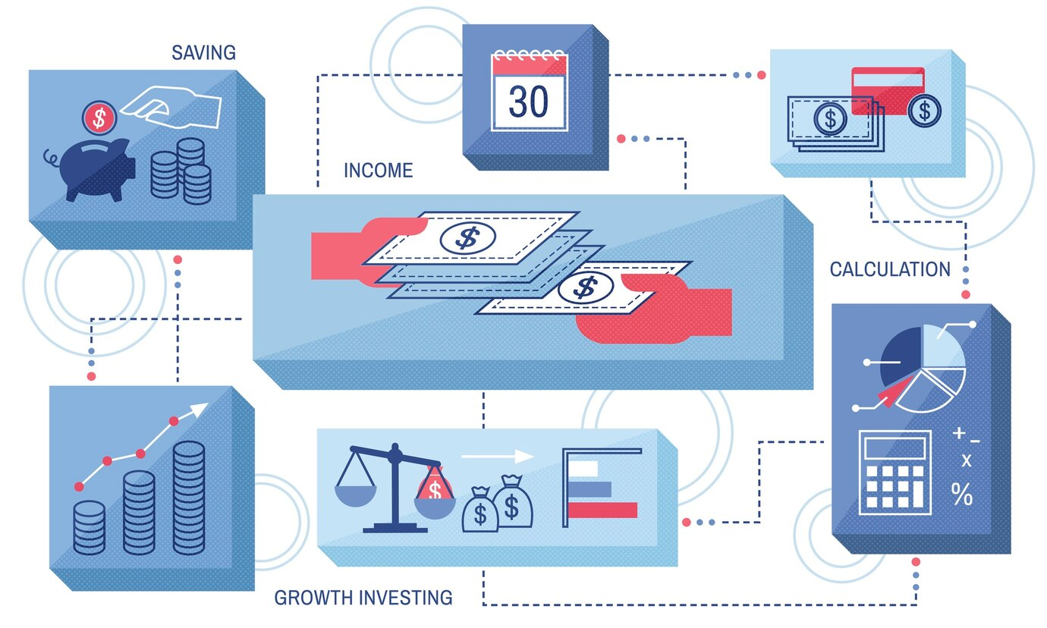
Key Takeaways
A well-structured bookkeeping and accounting system helps you avoid errors, stay compliant, and maintain financial health. By following best practices and adjusting your system to suit your business needs, you’ll be able to manage and grow your business efficiently.

Slide 20
Ensure Good Accounting…

