Slide 1
Navigating Estonia's Tax System & Business Registration
Leveraging E-Services for Seamless Business Management

Slide 2
Learning Outcomes
Understanding Estonia's E-Services and how to access them
Steps for registering a business and self-employed status
VAT registration requirements and process
Overview of the e-Tax system
Key considerations for taxable payments

Slide 3
E-Services in Estonia
Estonia offers one of the most advanced digital infrastructures in the world, with nearly all public services available online. This system is operational 24/7, enabling business owners to manage their companies from anywhere.
Access e-services here
Once logged in, you’ll see a dashboard that offers a comprehensive view of your tax, customs information, and liabilities.

Slide 4
E-Services in Estonia
Authentication Methods
To access Estonia’s e-services, several authentication options are available:
ID-card (includes digital ID, e-residency card, and diplomatic card)
Mobile-ID
Smart-ID
EU e-ID These provide secure and convenient ways to access government services remotely.

Slide 5
E-Services in Estonia

Slide 6
E-Services in Estonia
E-MTA User Account
Every individual with an Estonian personal ID number automatically receives an e-MTA user account. Non-residents who don’t have an Estonian ID will get an account upon their first successful login.
For more information on setting up accounts for non-residents, check here.

Slide 7
Business Registration for the Self-Employed
Estonia’s E-Business Register allows users to handle all business-related documentation electronically, eliminating the need for notaries. This portal facilitates:
Registering a new company
Amending company details
Filing for liquidation or removing a company from the registry
Submitting annual reports
Estonian, Latvian, Lithuanian, Finnish, and Belgian ID cards, as well as Smart-ID, can be used for login. However, note that petitions and reports can’t be signed using all ID cards.

Slide 8
Business Registration for the Self-Employed

Slide 9
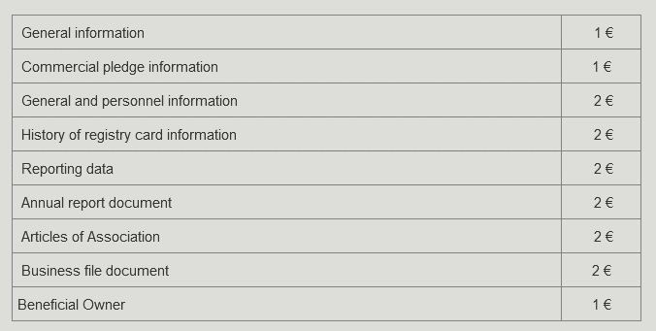
Fees and Activity Codes
Certain government services come with fees. You can check the fees for various business services here. ➔
For business activity codes, retrieve the relevant information here.or contact the Estonian Business Registry for assistance with specific codes tegevusala.emtak@rik.ee

Slide 10
VAT Registration Overview
When setting up a business in Estonia, you aren’t automatically liable for VAT. A company must register for VAT when its annual turnover reaches EUR 40,000. Below this threshold, VAT registration is voluntary.
Is VAT registration beneficial? Consider whether your customers are VAT-registered businesses and the input VAT on your purchases.
Once the threshold is exceeded, you have three business days to register as a VAT payer.

Slide 11
VAT Registration Process
It’s advisable to anticipate VAT registration if you expect your turnover to exceed EUR 40,000. As a VAT payer, you’ll need to:
Pay VAT to the Estonian Tax and Customs Board
Submit monthly VAT declarations These responsibilities remain even for months with no VAT transactions.

Slide 12
Voluntary VAT Registration
If you want to register for VAT before reaching the threshold, submit evidence (e.g., a business plan) to prove your intention to start operations. Note that the Tax Board might reject your application if you don’t have Estonian-based transactions.
You’ll be informed of the decision within five business days, and the registration will be retroactive to the date of application.

Slide 13
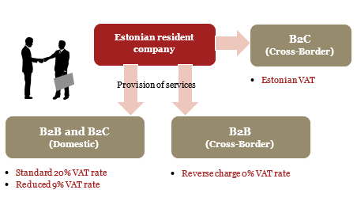
VAT Rates and International Transactions
Estonian businesses typically apply a 20% VAT rate for domestic transactions, with a reduced 9% VAT for services like accommodation or the sale of books and pharmaceuticals. Services provided to other EU countries or third countries usually qualify for a 0% VAT rate.
In B2B transactions within the EU, apply the reverse charge mechanism—your customer will account for VAT in their country.

Slide 14
VAT Reporting
Estonian companies must submit VAT declarations on a monthly basis. This includes VAT returns for goods/services purchased using the reverse charge mechanism from other EU countries.
Declarations must be filed by the 20th of the following month using the e-Tax portal. Monthly invoices exceeding EUR 1,000 must be reported in detail.

Slide 15
E-Tax: Estonia’s Online Tax Filing System
Estonia’s e-Tax system allows businesses to file tax declarations digitally. With 98% of tax filings done online, the system supports various functions:
Filing declarations for income tax, social tax, unemployment insurance, and pension contributions
Requesting VAT returns
Filing excise duty returns
Submitting customs declarations
Access the e-Tax service by logging into your EMTA account.

Slide 16
E-Tax
You can access e-Tax service by signing in to your EMTA account. Click Here.

Slide 17
Understanding Taxable Payments
In Estonia, expenses incurred for business purposes are evaluated monthly, unlike traditional systems where deductions are made annually. Routine operational expenses (e.g., rent, utilities) are typically exempt from extensive scrutiny.
However, non-business-related expenses are subject to corporate income tax (CIT) and must be reported accordingly.

Slide 18
Assessing Taxable Payments
When evaluating whether an expense is tax-deductible, ask:
Does this expense support or grow my business? If the expense is not essential to your business, it may trigger CIT.
Be mindful of specific rules around taxable items like gifts, donations, and fringe benefits.

Slide 19
Gifts and Donations
Small-value items such as promotional giveaways (under EUR 10) are generally exempt from CIT. For donations, tax-exempt status can be applied if given to approved non-profits. The annual limit for tax-exempt donations is either:
3% of payroll costs or
10% of last year’s profits
Declare both taxable and non-taxable gifts or donations in TSD Annex 5 on your tax return.
Public Data Inquiries.

Slide 20
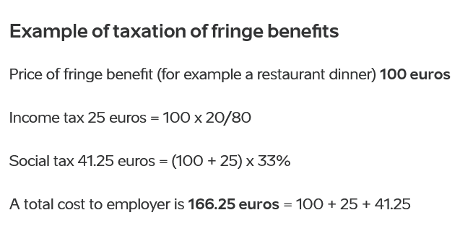
Gifts and Donations
To know how much tax-exempt donations a company can make, two alternative calculations can be compared: 1) the company can choose to either apply 3% of payments subject to social tax from the beginning of the calendar year (personalized payments such as salaries); or 2) 10% of the previous financial year’s accounting profits
In order to have the option to choose the more beneficial threshold, be sure to insert last year’s profit into the tax return.
All donations both under and over the relevant threshold should be declared on tax return TSD Annex 5. Gifts to employees and management board members are taxed as fringe benefits.
More information on tax payment can be found here.

Slide 21
Actionable Activity
Explore Estonia's online portals and services using the links provided. Familiarize yourself with the digital infrastructure that will support your business operations.

Slide 22
Keep updated on the processes…

